Slide 1

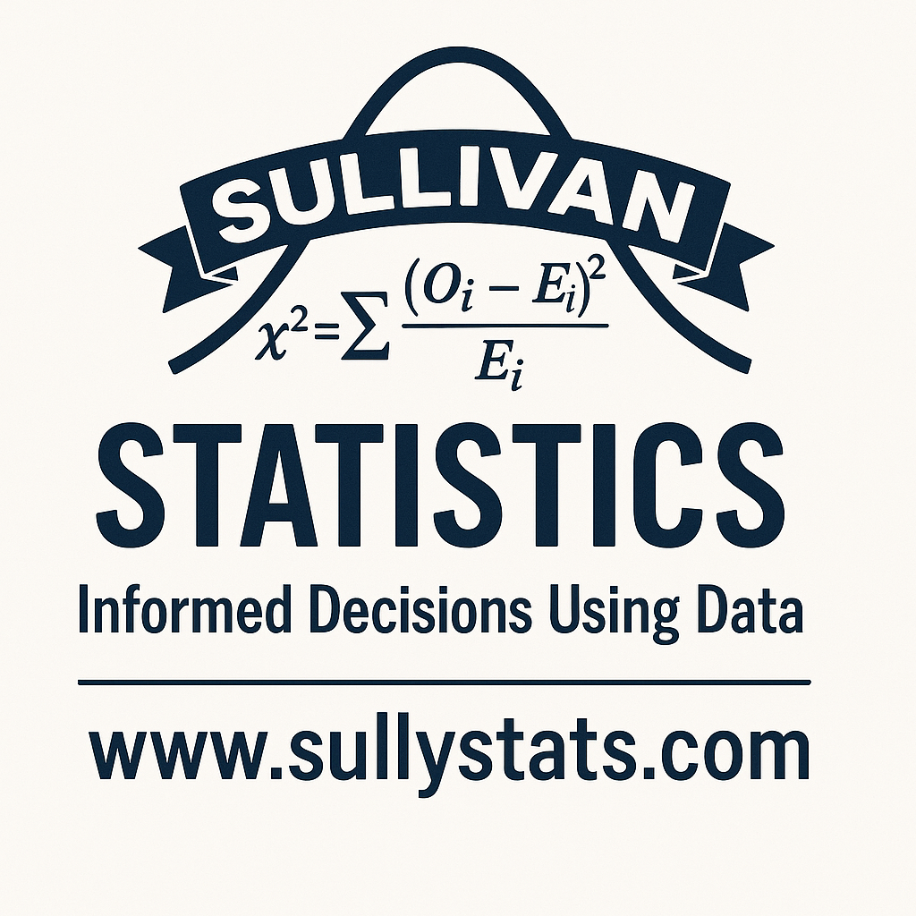
Modern Introductory Statistics
sullystat@gmail.com
michael.sullivan@fsw.edu

Slide 2
My History with Illinois Community Colleges and IMACC
Student at Moraine Valley
Taught economics, finite math, and statistics at MVCC (adjunct)
Taught economics at Oakton Community College (adjunct)
Tenure-track at South Suburban College
Attended first IMACC in 1996 with my father
Tenure-track at Joliet Junior College
Now at Florida SouthWestern State College

Slide 3
GAISE Outline
Teach statistics and data science as processes of gleaning insights from data to inform evidence-based decisions.
Emphasize effective written and oral communication of results from data, with attention to the scope and limitations of conclusions.
Focus on conceptual understanding rather than algebraic manipulation and formulas.
Integrate real data with a context and purpose throughout the course. Select data that are meaningful and engaging to the students.
Encourage multivariable thinking
Incorporate software/apps to explore concepts and work with data.
Emphasize responsible and ethical conduct in the collection and use of data in their analysis.
Employ evidence-based pedagogies that actively engage students in the learning process.
Use a variety of formative and summative assessments to improve teaching and learning.
Implement inclusive strategies that create learning environments where all students are valued.
Notes:
https://amstat.quarto.pub/college-gaise/recommendations.html

Slide 4
GAISE Outline
Teach statistics and data science as processes of gleaning insights from data to inform evidence-based decisions.
Emphasize effective written and oral communication of results from data, with attention to the scope and limitations of conclusions.
Focus on conceptual understanding rather than algebraic manipulation and formulas.
Integrate real data with a context and purpose throughout the course. Select data that are meaningful and engaging to the students.
Encourage multivariable thinking
Incorporate software/apps to explore concepts and work with data.
Emphasize responsible and ethical conduct in the collection and use of data in their analysis.
Employ evidence-based pedagogies that actively engage students in the learning process.
Use a variety of formative and summative assessments to improve teaching and learning.
Implement inclusive strategies that create learning environments where all students are valued.

Slide 5
Data Frames
To encourage multivariate thinking, I would recommend a data frame that is utilized throughout the semester. By using a data frame, we are showing data as it is presented in the real world. Data frames have multiple variables with many, many observations. It is important for students to see these data frames and extract the variable or variables needed to answer questions posed.
https://sullystats.pub/NHANES
Notes:
There are plenty of interesting data frames that are relatively easy to extract. One place to look would be any city’s data portal or the CDC. Here we will consider the national health and nutrition examination survey from the CDC.

Slide 6
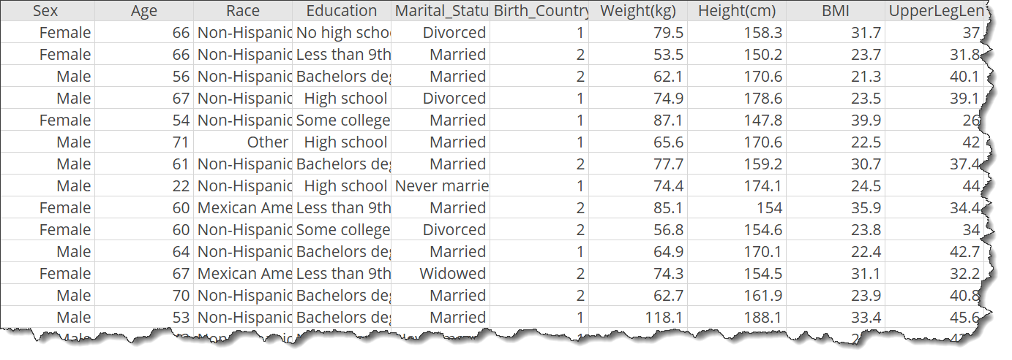

Slide 7
The data frame “Health_Nutrition” is located at https://sullystats.pub/NHANES.
The variable Energy represents the number of calories consumed by the respondent on the day of the survey. Suppose you wanted to build a linear model to predict the number of calories consumed in a day based on the NHANES data. Among BMI (body mass index), upper leg length, waist circumference, total cholesterol, and protein, which variable would be the best predictor of calories consumed?
Build a least-squares regression model treating calories consumed as the response variable using the variable you identified in part (a).

Slide 8
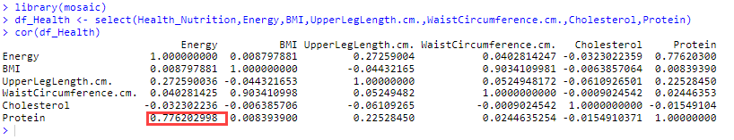
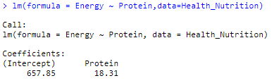

Slide 9

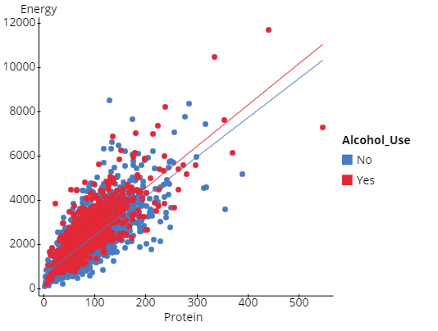

Slide 10
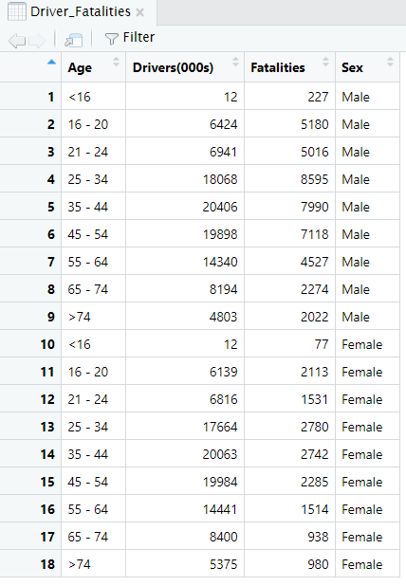
Least-Squares Regression
The data to the right represent the number of licensed drivers in various age groups (in thousands) and the number of fatal accidents within the age group by sex. The data may be found in the ICTCM group in StatCrunch or at
https://sullystats.github.io/Data/Driver_Fatalities.csv
Draw a scatter diagram treating number of drivers as the explanatory variable and fatalities as the response variable by sex.

Slide 11

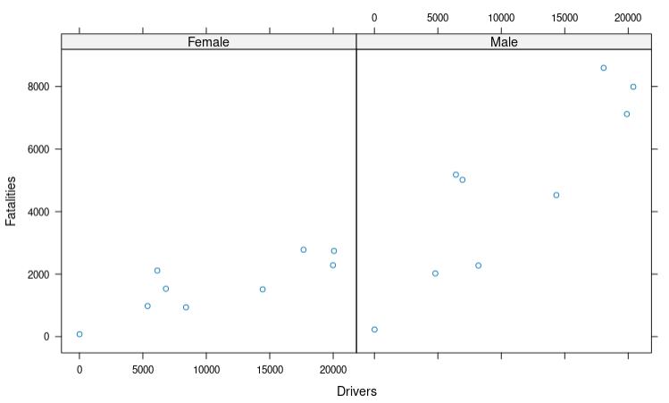

Slide 12
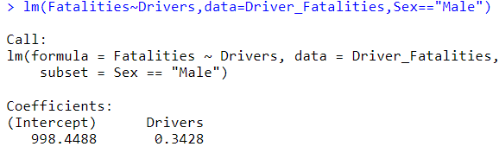
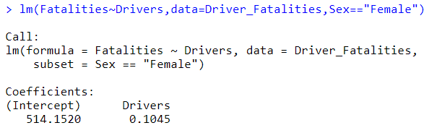
Find the least-squares regression line for males treating fatalities as the response variable and number of drivers as the explanatory variable. Repeat this procedure for females. How might an insurance company use this result?

Slide 13
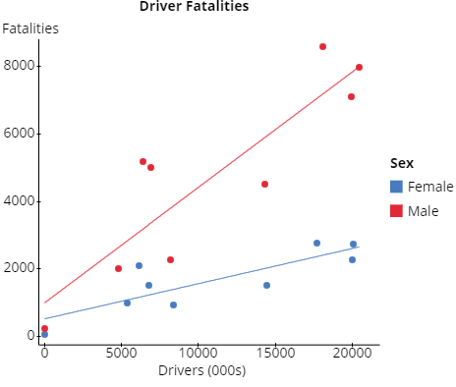
What role, if any, does age play in driver fatalities?
Notes:
Load data in StatCrunch. Graph > Scatter Plot. X and Y variable. Group by Sex. Overlay polynomial of degree 1 (best fit). Add Age to hover info. Use mouse to highlight observations.

Slide 14
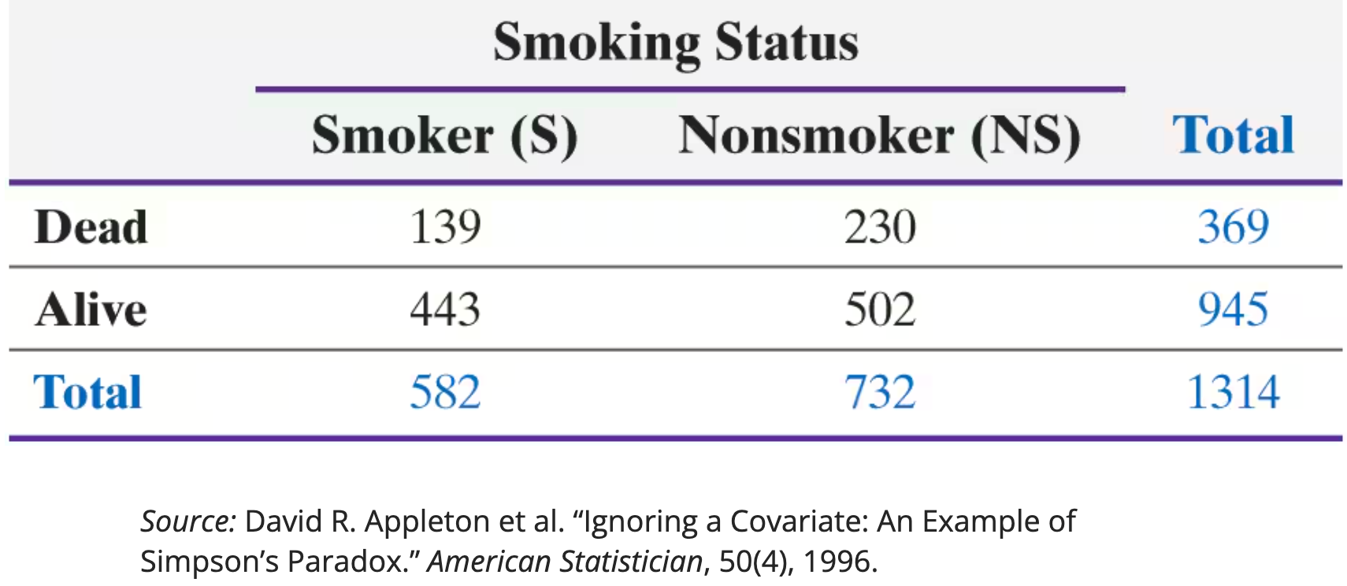

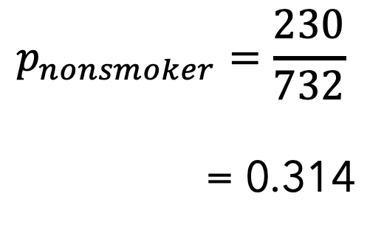
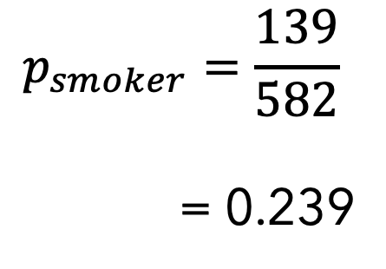
Could it be that smoking increases survival rates among women? The data to the left represent the $20\text{−}\text{year}$ survival status and smoking status of $1314$ self-identified women from the United Kingdom who participated in a cohort study from 1972 to 1992.
What proportion of the smokers was dead after $\text{20} \text{years}$?
What proportion of the nonsmokers was dead after $\text{20} \text{years}\text{?}$
What does this imply about the health consequences of smoking?
$$p_{smoker}=\frac{139}{582}$$
= 0.239
$$p_{nonsmoker}=\frac{230}{732}$$
= 0.314
Notes:
Looks like we should all take up smoking!

Slide 15
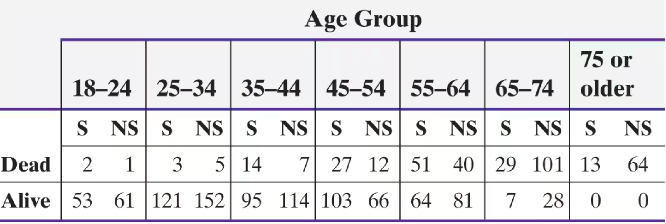


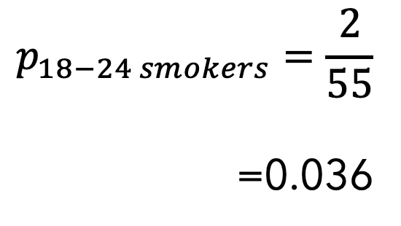
The data in the table in the previous slide do not take into account a variable that is strongly related to survival status, age. The data to the left give the survival status of women and their age at the beginning of the study. For example, $14$ women who were $35$ to $44$ at the beginning of the study were smokers and dead after $\text{20} \text{years}\text{.}$
Determine the proportion of 18- to 24-year-old smokers who were dead after 20 years.
Determine the proportion of 18- to 24-year-old nonsmokers who were dead after 20 years.
$$p_{18−24 smokers}=\frac{2}{55}$$
=0.036
$$p_{18−24 nonsmoker}=\frac{1}{62}$$
= 0.016
Notes:
When taking age into account, the direction of
association changed. In almost all age groups, smokers had a higher
death rate than nonsmokers. The most notable exception is for the 25
to 34 age group, the largest age group for the nonsmokers. A possible
explanation could be rigorous physical activity (e.g., rock climbing)
that nonsmokers are more likely to participate in than smokers.

Slide 16
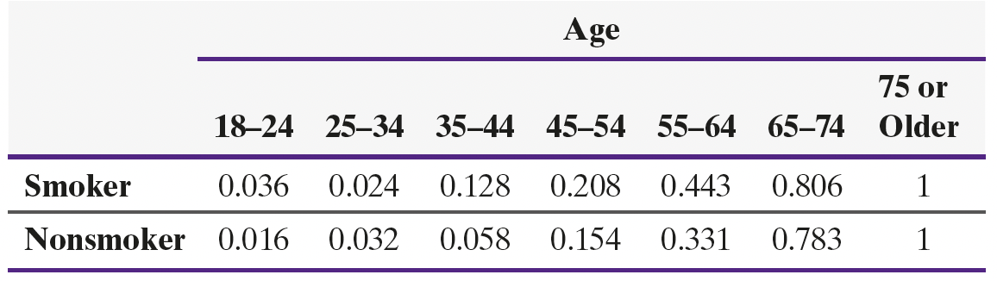
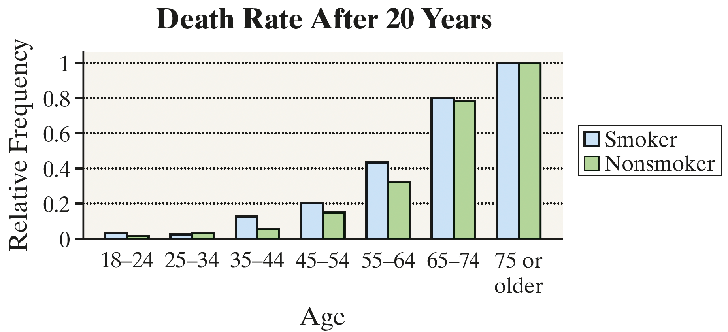
Notes:
Summarize the results in a table. If the victim is Black, the Black offender gets a death sentence at a higher rate. If the victim is white, the black offender gets a death sentence at a higher rate. So, the apparent conclusion that whites get death penalty at a higher rate inverts when the variable “race of the victim” is added to the analysis. This phenomena is known as “Simpson’s Paradox”.

Slide 17
Simpson’s Paradox
Simpson’s Paradox describes a situation in which an association between two variables inverts or goes away when a third variable is introduced to the analysis.

Slide 18
The Meaning of Level of Confidence
Open the data at
https://sullystats.github.io/Data/1950-2024_tornadoes.csv

Slide 19
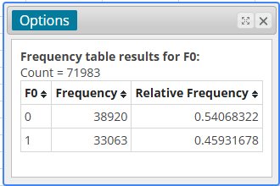
Population Proportion of F0 Tornadoes: 0.459
Notes:
To create the variable F0, where 1 represents an F0 tornado and 0 represents something other than an F0 tornado, go to StatCrunch. Select Data > Compute > Expression. Enter
Ifelse(F_scale=0,1,0)

Slide 20
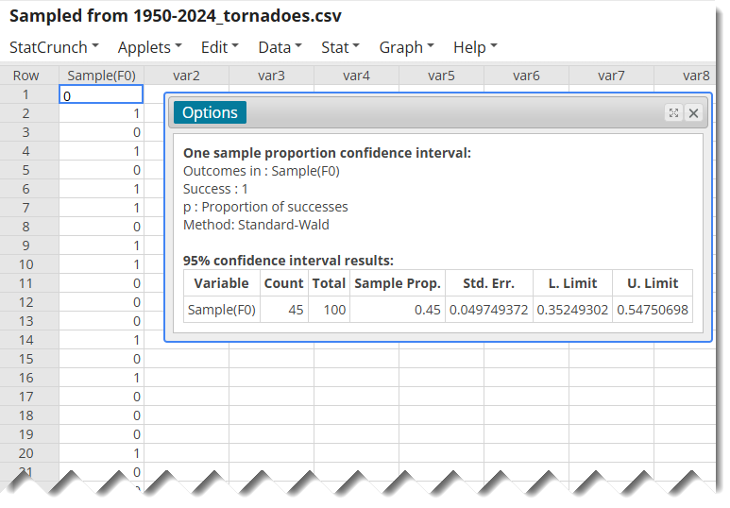
Obtain a Random Sample from the New Variable and Construct a 95% Confidence Interval
Notes:
1. Data > Sample
2. Sample size 100. Store data in new data table.
Confidence Interval: Stat > Proportion Stats > One Sample > With Data

Slide 21
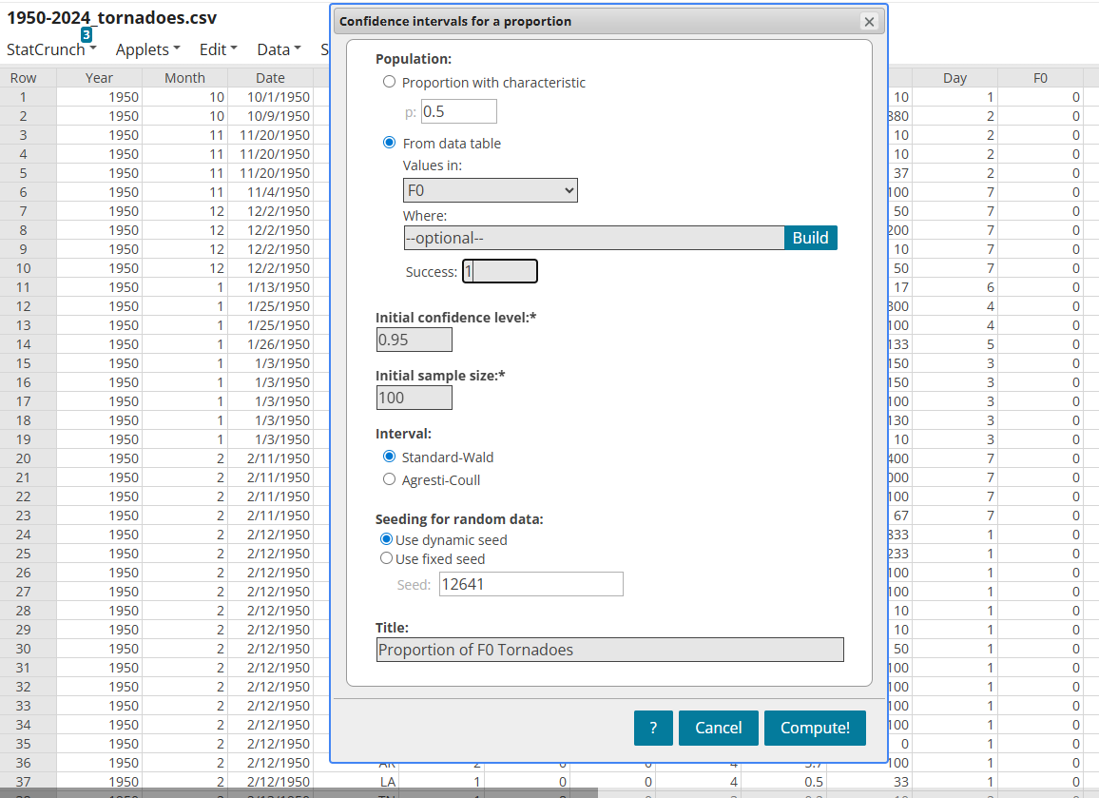
Repeat this Process Many Times (Applet)
Notes:
Use the StatCrunch “Confidence Interval” applet to see the role of level of confidence.

Slide 22
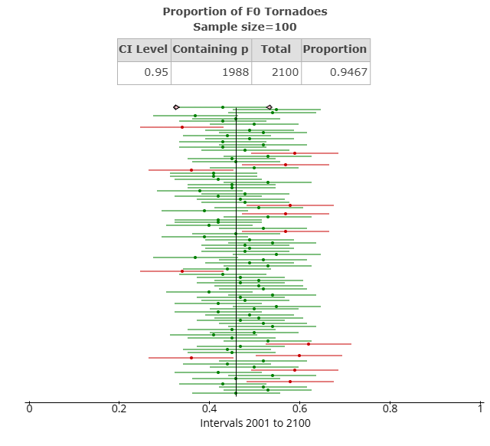
Results
Notes:
Applets > Confidence Interval > Proportion
Choose from raw data

Slide 23

What Is a P-value?

Slide 24
A Small p-value suggests one of two things:
The statement in the null hypothesis is true and we observed an unusual result
The statement in the null hypothesis is not true
Notes:
In hypothesis testing, the null hypothesis is a statement of “no change” or “no effect”. The idea behind hypothesis testing is to judge whether an observed difference is unusual under the assumption the statement in the null hypothesis is reality. This is done via the P-value. The P-value is the probability of observing an effect as extreme or more extreme than that observed assuming the statement in the null hypothesis is true. A “small” P-value means one of two things:
The statement in the null is true and we observed an unusual result.
The statement in the null is not true.

Slide 25
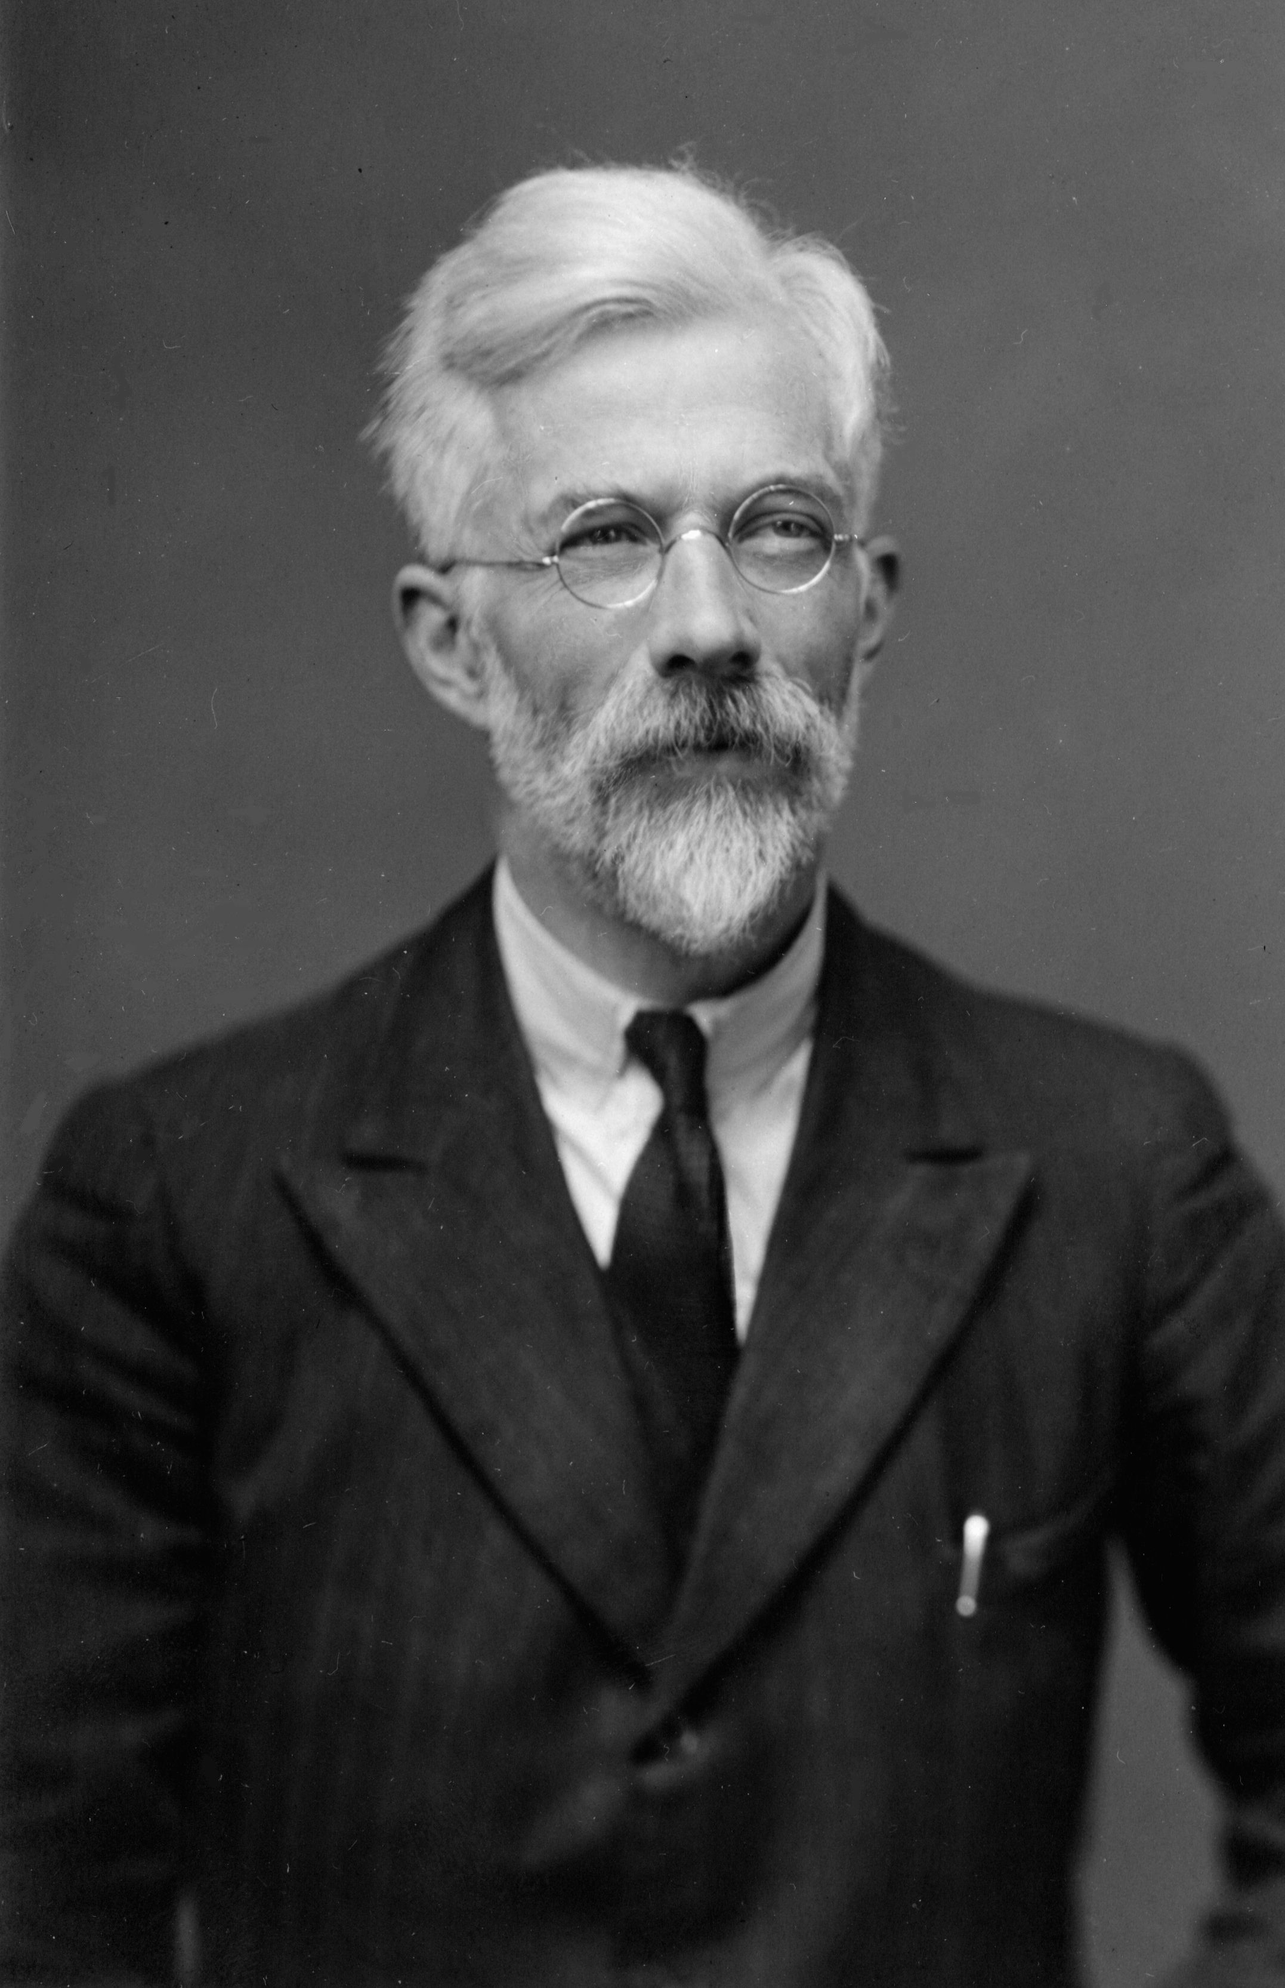
“No scientific worker has a fixed level of significance at which from year to year, and in all circumstances, he rejects (null) hypotheses; he rather gives his mind to each particular case in the light of his evidence and his ideas.”
-Ron Fisher (1956)
Notes:
According to Ron Fisher, the smaller the P-value, the stronger the evidence against the statement in the null hypothesis. How small should the P-value be to reject the statement in the null – that is up to the researcher (and should be decided prior to the data collection/data analysis phase of the study process). In 1926 Fisher suggested levels of significance of 1% or 5% depending on the goals of the research (or the consequences of making a Type I Error). The only reason the 1% or 5% level of significance is in use is because these values were printed in his book (due to constraints of the printed page). In 1956 Fisher elaborated by saying, ““no scientific worker has a fixed level of significance at which from year to year, and in all circumstances, he rejects (null) hypotheses; he rather gives his mind to each particular case in the light of his evidence and his ideas.” Fisher also indicated that a small P-value warrants further investigation – not that a small P-value means the case is closed.

Slide 26


H_{o}: Statement of no change (no wedding)
H₁: Statement looking to gather evidence in support of (wedding)
Notes:
As Ron Wassertein (former president of the American Statistical Association) so aptly put it, a small P-value is like a good first date. You are not ready for a wedding but are certainly willing to investigate the relationship further.
H0: Statement of no change (no wedding) H1: Statement looking to gather evidence in support of (wedding)
That is, more dates mean more data. Hopefully, each date leads to data that allows for rejection of the null hypothesis. My wife calls me a Type I Error.

Slide 27
Do your students understand what a P-value measures?
Notes:
If you asked your students to define a P­-value, what type of response would you get? Do you believe your students have a solid grasp of what a P­-value represents? Do you believe that students truly understand what the models we use to obtain a P-value actually represent?
If the answer to your question is “no”. Don’t feel bad. It’s a complicated concept. Let’s look at some activities that help develop a better understanding of P-values.

Slide 28
Using an Urn
The proportion of the human population that is left-handed is 0.12. Mensa is an organization of high-IQ individuals (to qualify to be a member of Mensa one’s IQ must be at the 98th percentile). In a random sample of 20 members of Mensa, it was found that 4 were left-handed. Does this result suggest that a higher proportion of Mensa members are left-handed than the general population?
What is the variable of interest in this study? Is it qualitative or quantitative?
Whether an individual is left-handed, or not. It is qualitative with two possible outcomes.
(b) What are the null and alternative hypotheses? H₀: p = 0.12 vs. H₁: p > 0.12
(c) Build a null model that could be used to simulate the outcomes of the study. Hint: There are approximately 120,000 members of Mensa worldwide. Under the assumption the null hypothesis from part (b) is true, how many of the 120,000 Mensa members would be left-handed? How many would not be left-handed?
(d) Simulate 5000 repetitions of this study. What does the result suggest?
(e) Use the binomial probability distribution function to find P(X > 4) where n = 20 and p = 0.12.
Notes:
(c) Let 120,000(0.12) = 14,400 green balls represent the left-handers. Let 120,000 - 14,400 = 105,600 red balls represent individuals who are not left-handed. Sample 20 balls. Set the radio button at “Number”. >= 4. Note that 4 is the “test statistic”.
We built a population of Mensa members under the assumption the statement in the null hypothesis is true.
In StatCrunch, select Applets > Simulation > Urn sampling.
(d) Click 1 Run.
Ask each student to do one run. Then ask if any obtained 4 or more who were left-handed.
Now click ”1000 runs” at least five times.

Slide 29
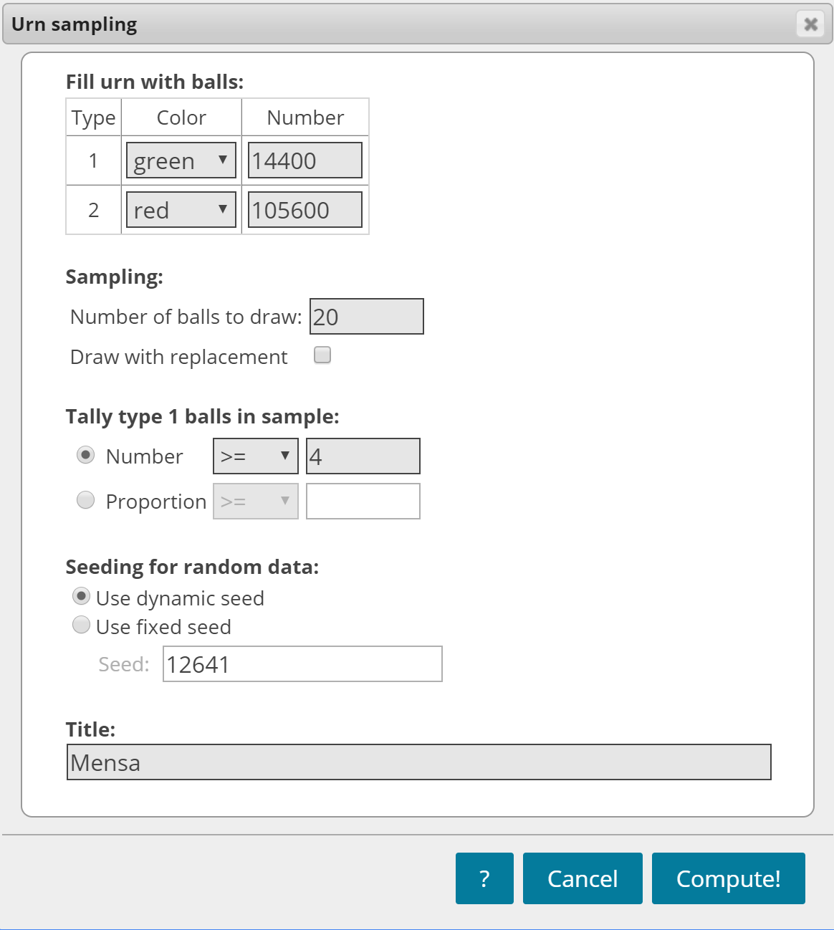
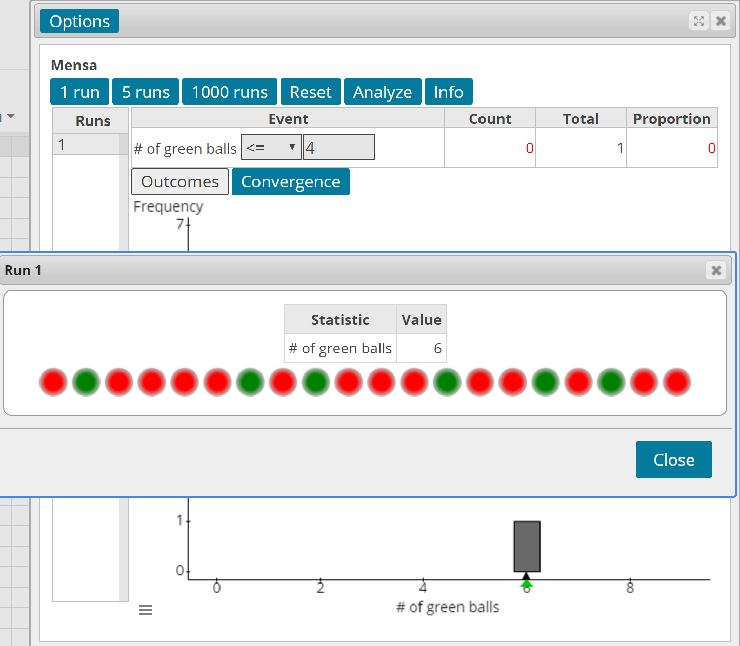

Slide 30
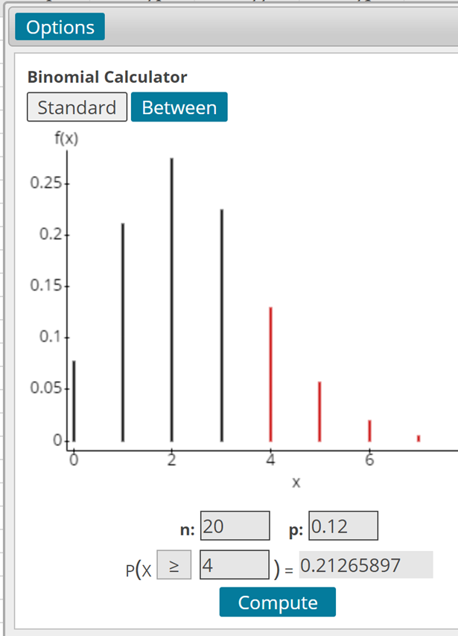
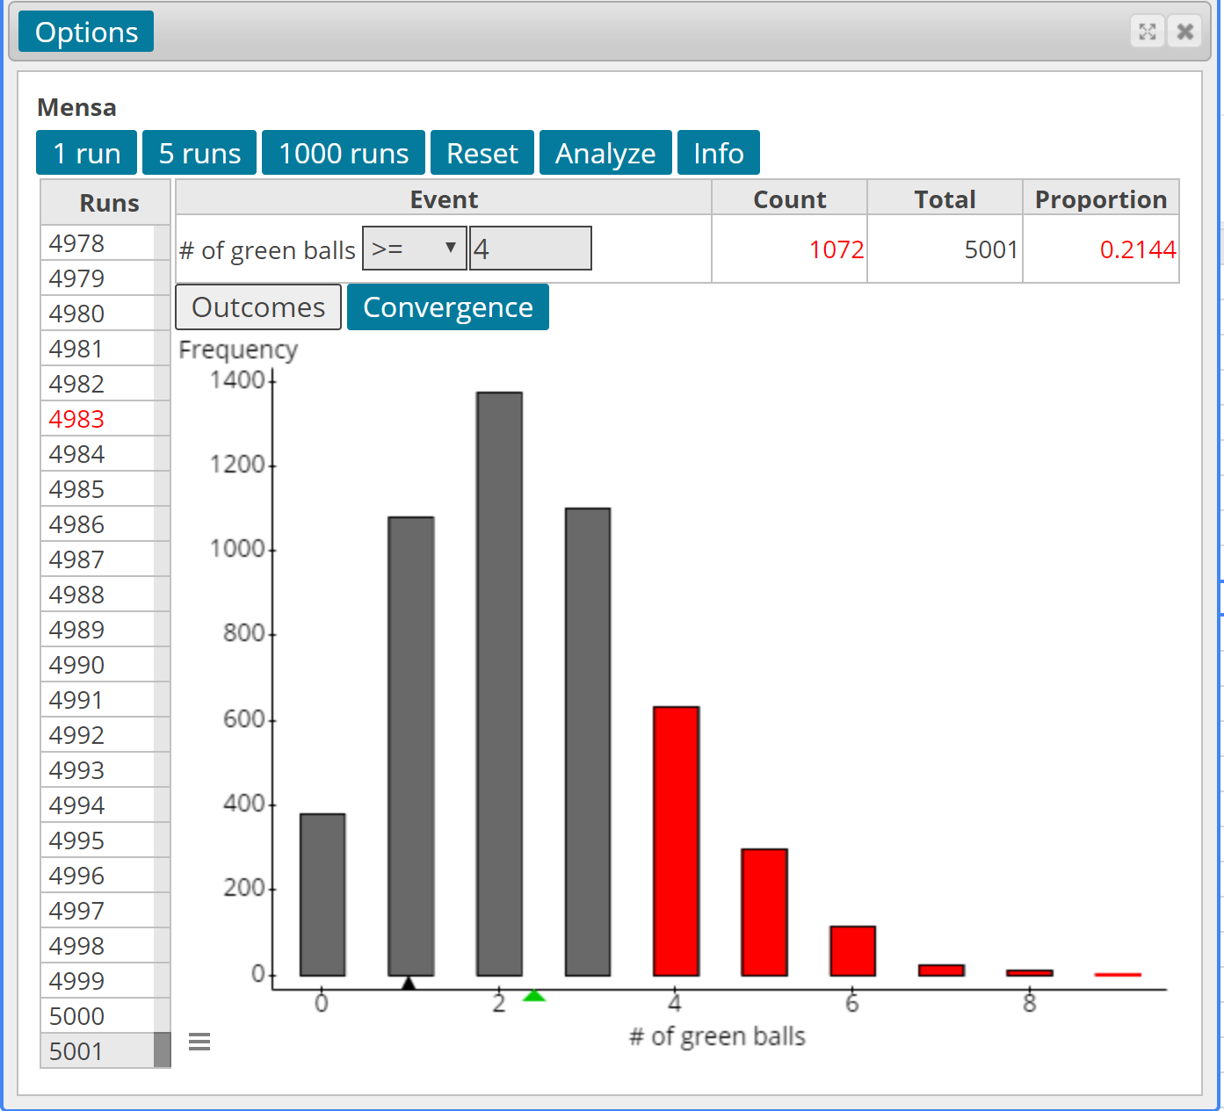
Notes:
For the binomial probability, select Stat > Calculators > Binomial
Encourage you to have each student do this and share their estimate of the P-value. Discuss why everyone is getting a different P-value. The discussion should center around the randomness of sampling – that is, sampling variability.
A major conclusion from this scenario is that it is very difficult to reject the statement in the null hypothesis (even for large absolute effect sizes) when the sample size is small. Note: the effect size here is the difference between the sample proportion and the proportion stated in the null hypothesis. So, the effect size is 0.2 – 0.12 = 0.08. Put another way, a small sample size leads to studies with weak power – the ability to correctly identify an effect (that is, correctly reject the statement in the null hypothesis).

Slide 31
The Role of Sample Size
The proportion of the human population that is left-handed is 0.12. Mensa is an organization of high-IQ individuals (to qualify to be a member of Mensa one’s IQ must be at the 98th percentile). In a random sample of 120 members of Mensa, it was found that 24 were left-handed. Does this result suggest that a higher proportion of Mensa members are left-handed that the general population?
Build the Urn applet again and run 5000 simulations. Be sure to select proportions.
Click Analyze. Find the mean and standard deviation of the 5000 sample proportions.
Determine the mean and standard deviation of the sample proportion assuming p = 0.12. Compare to part (b).
Use the normal model to find the probability of observing 24 or more left-handers from a population whose proportion is 0.12.
Notes:
A major conclusion from the previous scenario is that it is very difficult to reject the statement in the null hypothesis (even for large absolute effect sizes) when the sample size is small. Note: the effect size here is the difference between the sample proportion and the proportion stated in the null hypothesis. So, the effect size is 0.2 – 0.12 = 0.08. Put another way, a small sample size leads to studies with weak power – the ability to correctly identify an effect (that is, correctly reject the statement in the null hypothesis).
Simply Edit the previous Urn applet. Change number of balls to draw to 120. Could continue to use “Number” as the test statistic, but we are going to switch to Proportion >= 0.20. Note, we have the same effect size because the sample proportion is still 0.2 (=24/120 = 4/20).
For part (b), select Stat > Summary Stats > Highlight the mean and standard deviation.
For part (c), the theoretical mean is 0.12 and the theoretical standard error is sqrt(0.12*0.88/120) = 0.0297.
Part (d): Stat > Calculators > Normal. Compute P(phat >= 0.20).

Slide 32
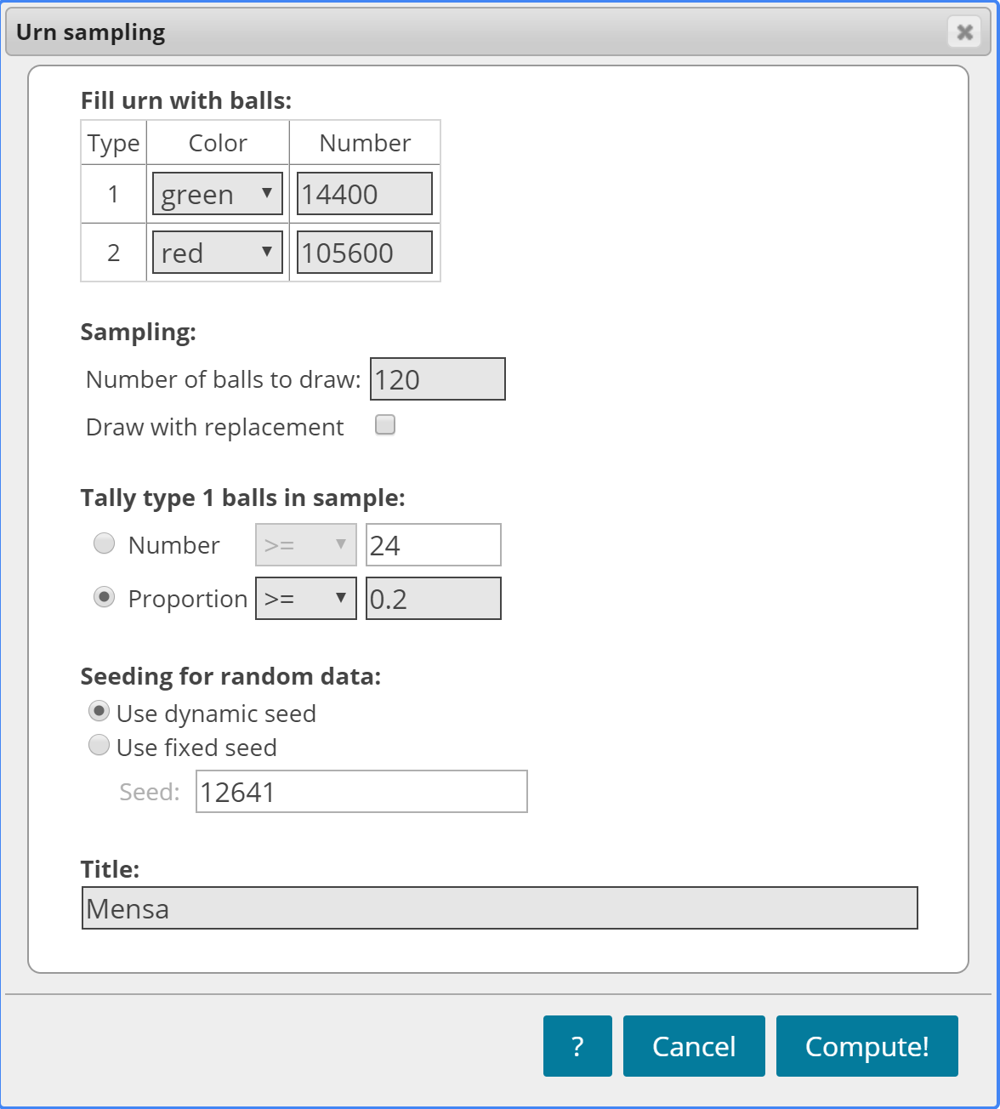
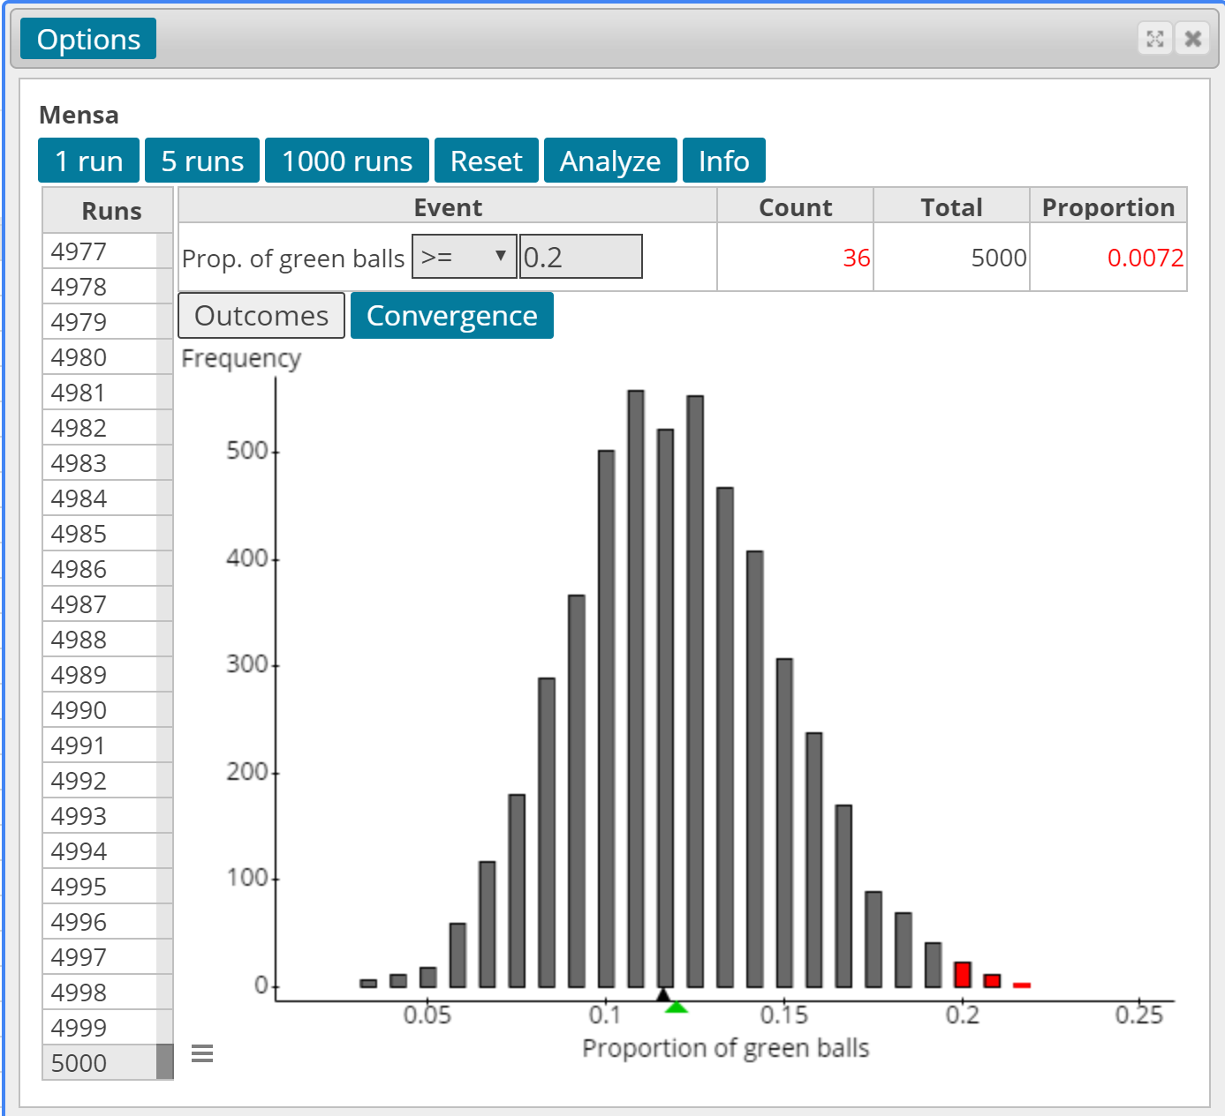
Notes:
For the same effect size as the example with a sample of size n = 20, the P-value is much smaller. And, look at the shape of the distribution of the proportion of green balls (the distribution of left-handers). What does this suggest?

Slide 33
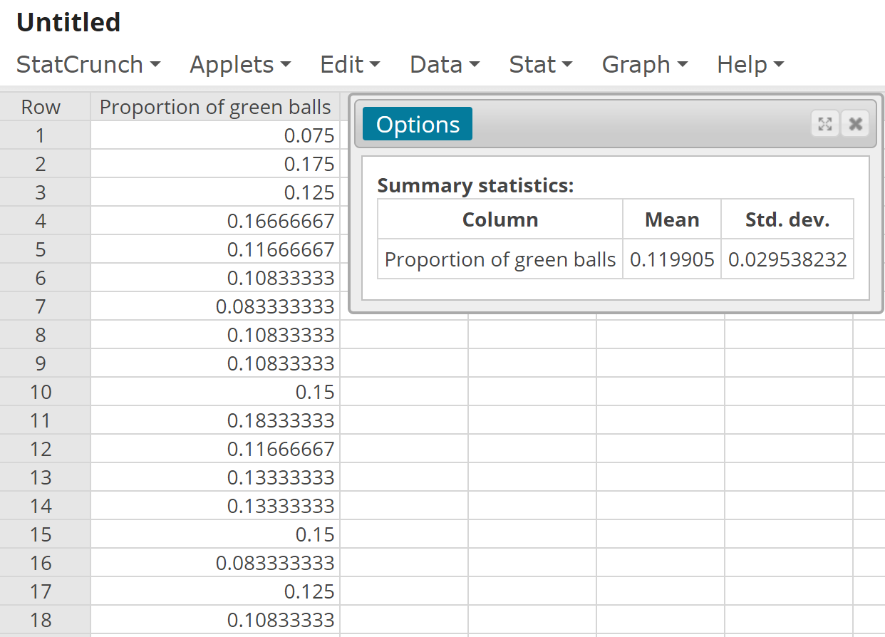
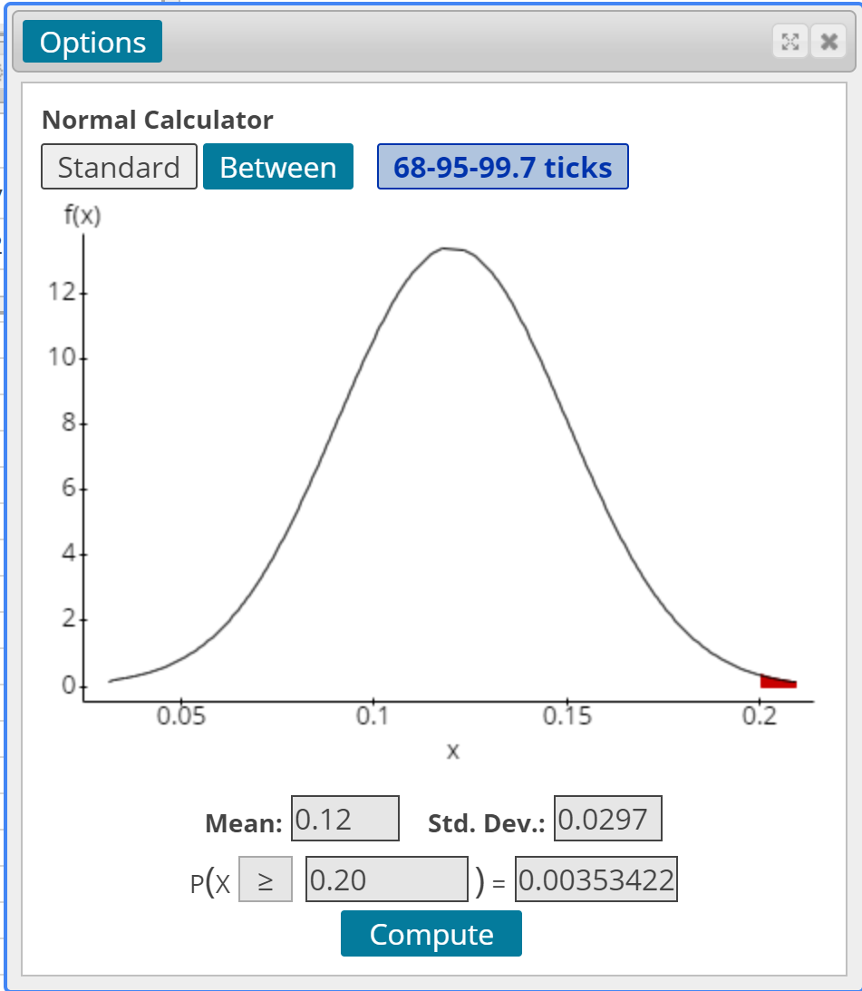
Notes:
For part (b), select Stat > Summary Stats > Highlight the mean and standard deviation.
For part (c), the theoretical mean is 0.12 and the theoretical standard error is sqrt(0.12*0.88/120) = 0.0297.
Part (d): Stat > Calculators > Normal. Compute P(phat >= 0.20).
Nice discussion point – cite a reason that the P-values might differ. Essentially, we are using a continuous distribution to model a qualitative variable with two outcomes.

Slide 34
Besides using an Urn to simulate for proportions, a coin may be used. The coin need not be fair.
Go to YouTube to see an example of this. I also have R code for simulating using a coin.
When does each make sense?
Is the scenario a sequence of events? Use the coin-flipping approach.
Is it easy to build a population? Use the urn approach.

Slide 35

Microsoft 365 Copilot is an AI-powered tool that may be used to assist in performing a variety of functions in Microsoft 365 products.

Slide 36
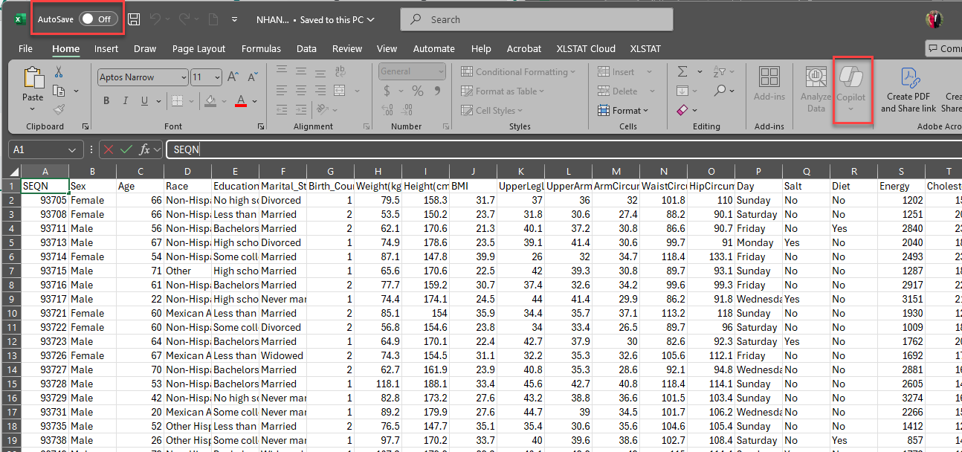
https://sullystats.github.io/Data/NHANES.csv
Notes:
To use Copilot, the AutoSave feature must be turned on and the file must be saved either in OneDrive or SharePoint. To use Copilot for Excel, the spreadsheet must be presented as a table.
First, Save As an xlsx file on One Drive. Then, click Home > Format as Table

Slide 37
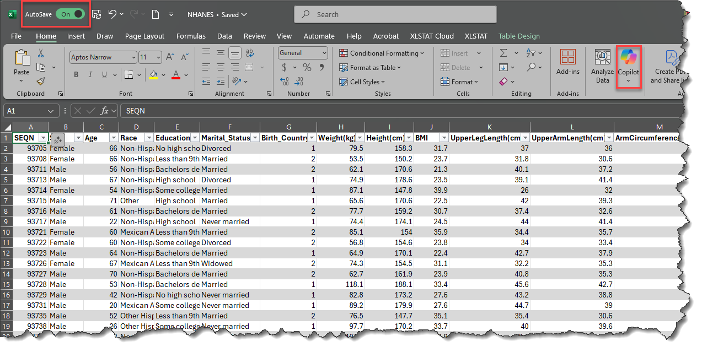
Notes:
We are now ready to analyze the data using Copilot. Copilot for Excel has a standard mode that utilizes commands in basic Excel and an advanced mode that utilizes commands in an opensource statistical package called Python.

Slide 38
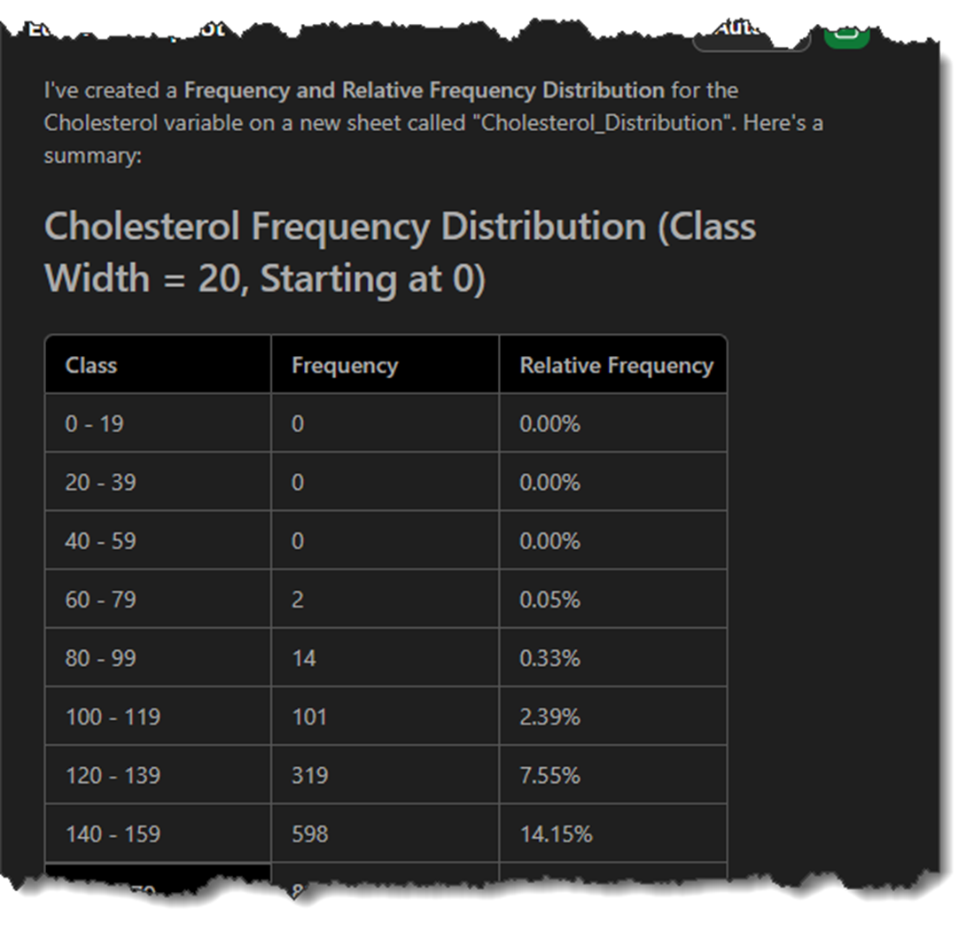
CoPilot: Use Python to construct a frequency and relative frequency distribution of the variable Cholesterol starting at 0 and a class width of 20.
Notes:
Notice how the intervals are constructed. We can fix this with an adjustment to our syntax.

Slide 39
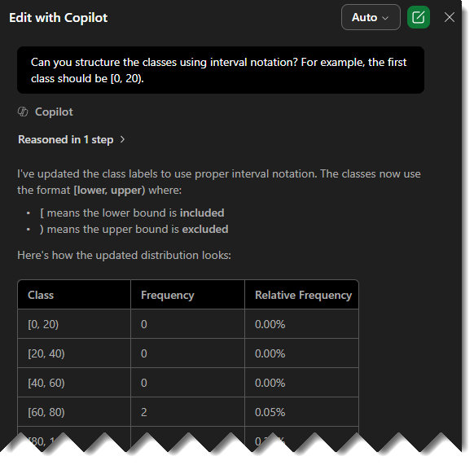
CoPilot: Can you structure the classes using interval notation? For example, the first class should be [0, 20).?

Slide 40
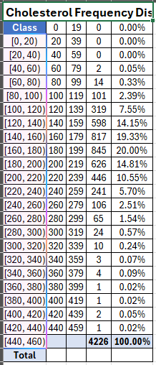

Slide 41
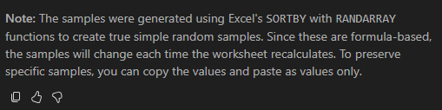
CoPilot: Obtain a simple random sample of size 20 for the variable Cholesterol for individuals whose Birth_Country = 1. Obtain an independent simple random sample of size 20 for the variable Cholesterol for individuals whose Birth_Country = 2.
Notes:
Would be a cool classroom activity to have each student obtain their own SRS of each birth country and compare P-values. A classroom discussion should take place to discuss what causes the different P-values.

Slide 42
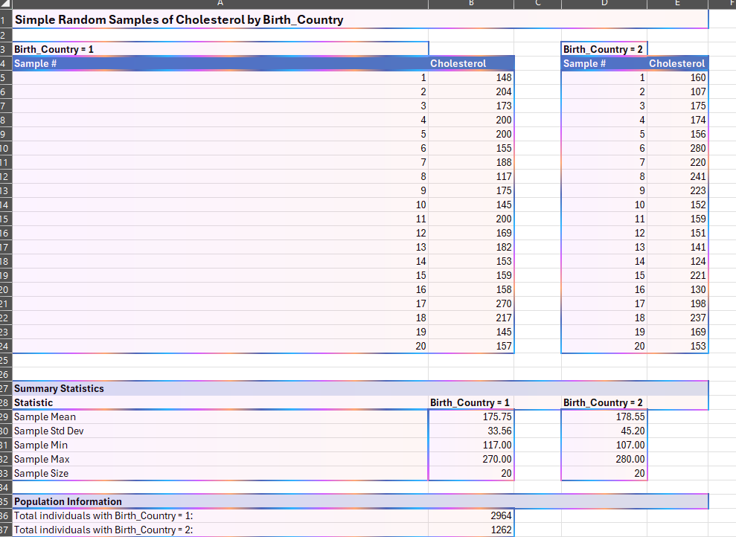
Notes:
In Cell B5, we see the code. Each time you hit enter, a new SRS of size 20 is generated. If you want, this can be shared with the students so they can each obtain their own SRS.

Slide 43
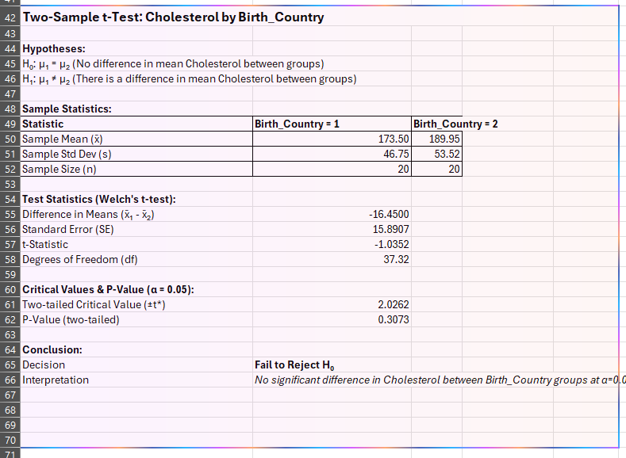
Use Student’s
t-distribution to test if the Cholesterol for Birth_Country=1 is different from the Cholesterol for Birth_Country=2.
Notes:
Each time you obtain a SRS, the spreadsheet recalculates the P-value of the hypothesis test. This allows you to demonstrate that the P-value is a random variables whose value is determined by the sample obtained. Copilot provides a detailed interpretation of the results.

