Slide 1
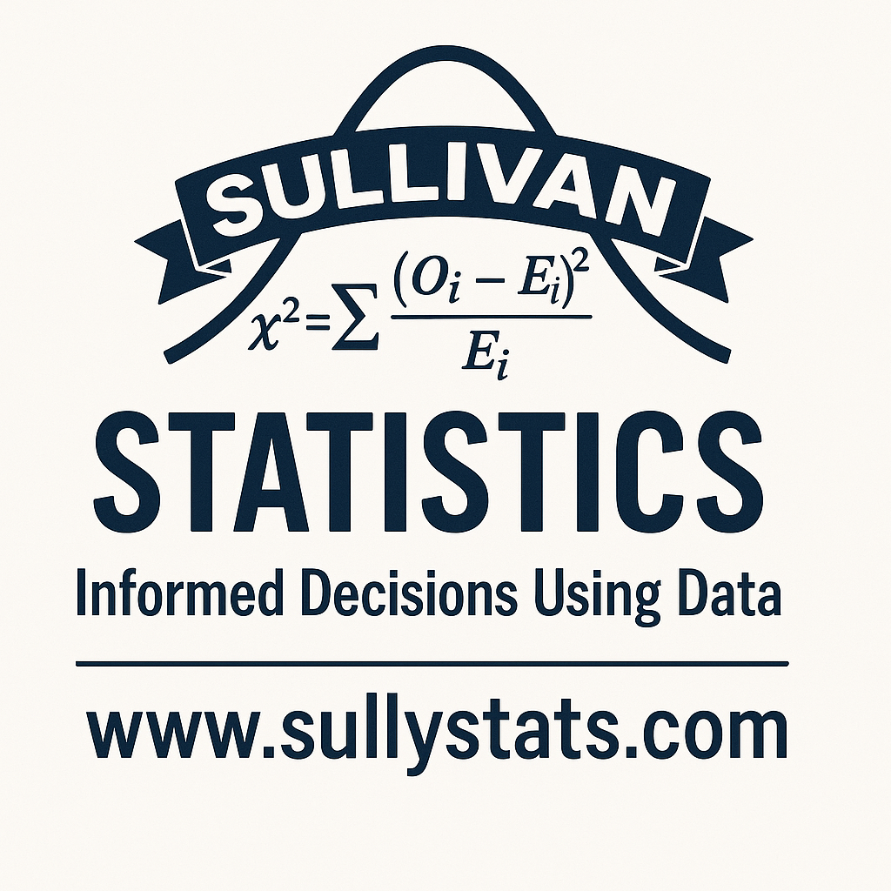
Using AI to Learn
Michael Sullivan
sullystats@gmail.com
michael.sullivan@fsw.edu

Slide 2
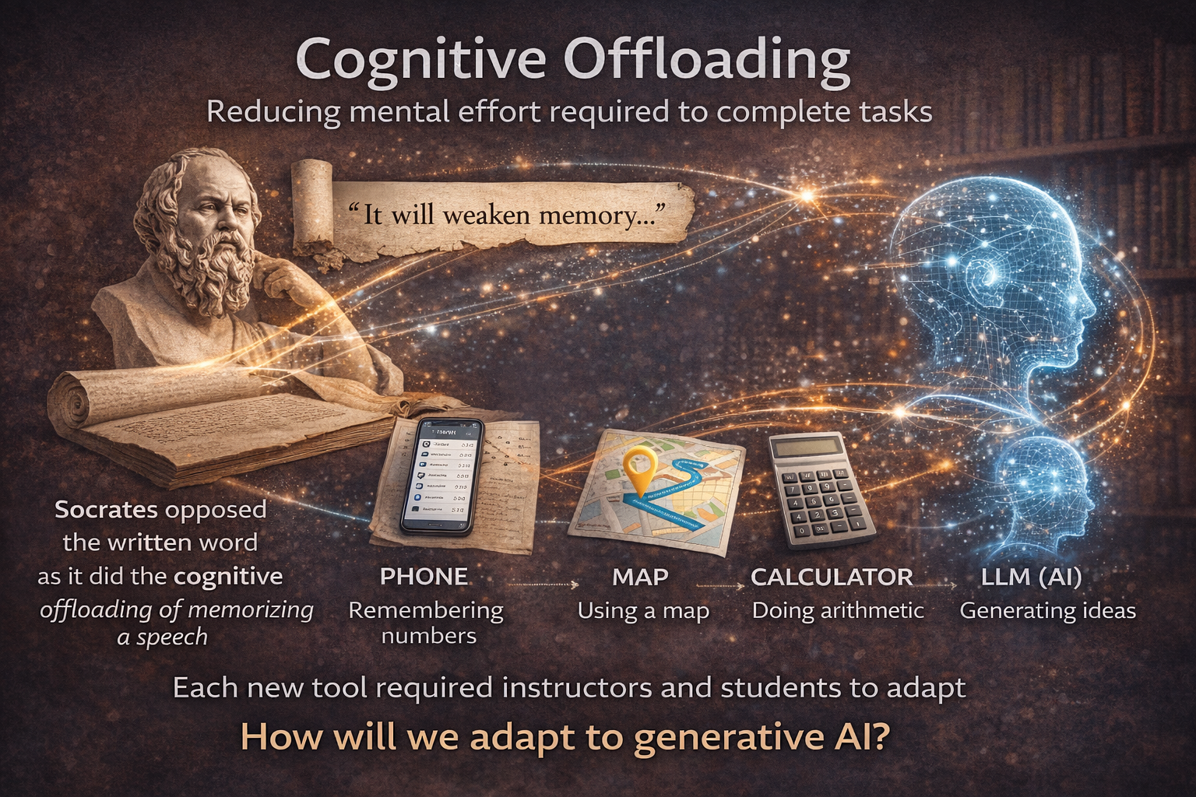
Notes:
Cognitive offloading is the process of using external tools or resources to reduce/replace the mental effort required to complete a task.. It is said that Socrates opposed the written word because it did the cognitive offloading of memorizing a speech. Some modern examples: remembering phone numbers…now phones do this; using a map…Waze; arithmetic…four-function calculators; and so on. Each time new technology is developed, instructors must adapt their approach to teaching and students must adapt the approach to learning.
Pascal invented the four-function calculator in the mid-1600s. Scientific calculators in the 1970s (goodbye to interpolation); graphing calculators in the late 1990s; we did this with computer algebra systems and statistical spreadsheets in the 2000s. We learned to “Google-proof” our exams. Now, we now need to figure this out with LLMs.

Slide 3
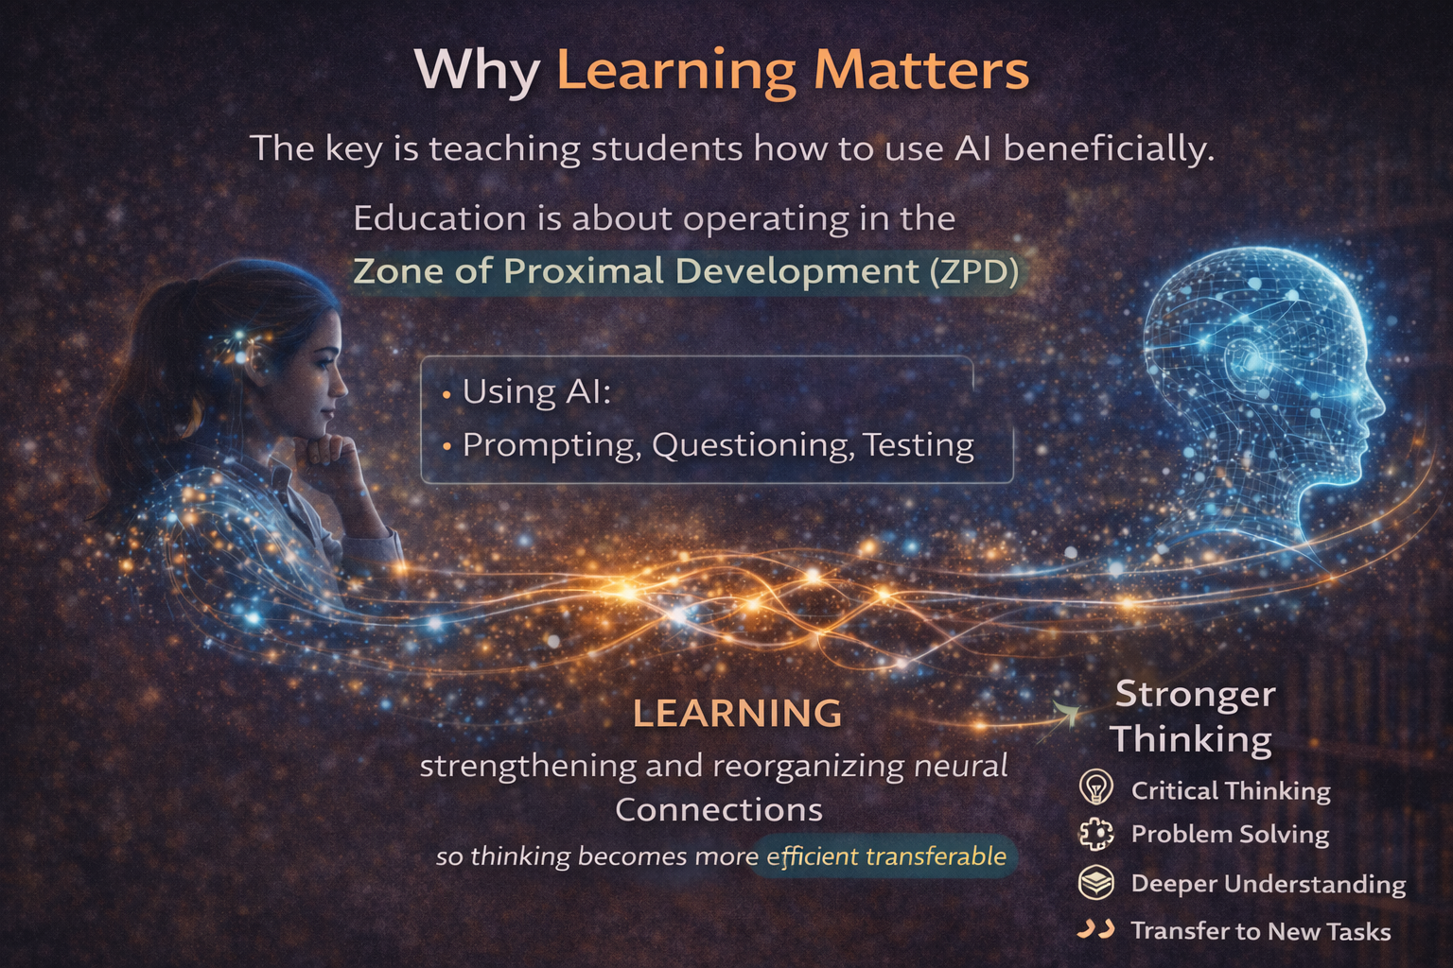
Notes:
The key is to teach students how to use this technology to their benefit.
They still must time in productive persistence or Zone of Proximal Development.
Learning is strengthening and reorganizing neural connections so thinking becomes more efficient and transferable..
Learning is active struggle that builds durable knowledge.
In higher education, we use various disciplines to develop these neural connections. College Algebra is to learning as a leg press is to developing strong legs.
Powerful neural connections is the difference of information retrieval using the old 5.25” floppy disks versus a solid-state hard drive.
If students don’t learn the material, the stress of an exam will make information retrieval difficult or impossible.
Can AI be used as a tool to assist learning?
Let’s look at some studies.

Slide 4
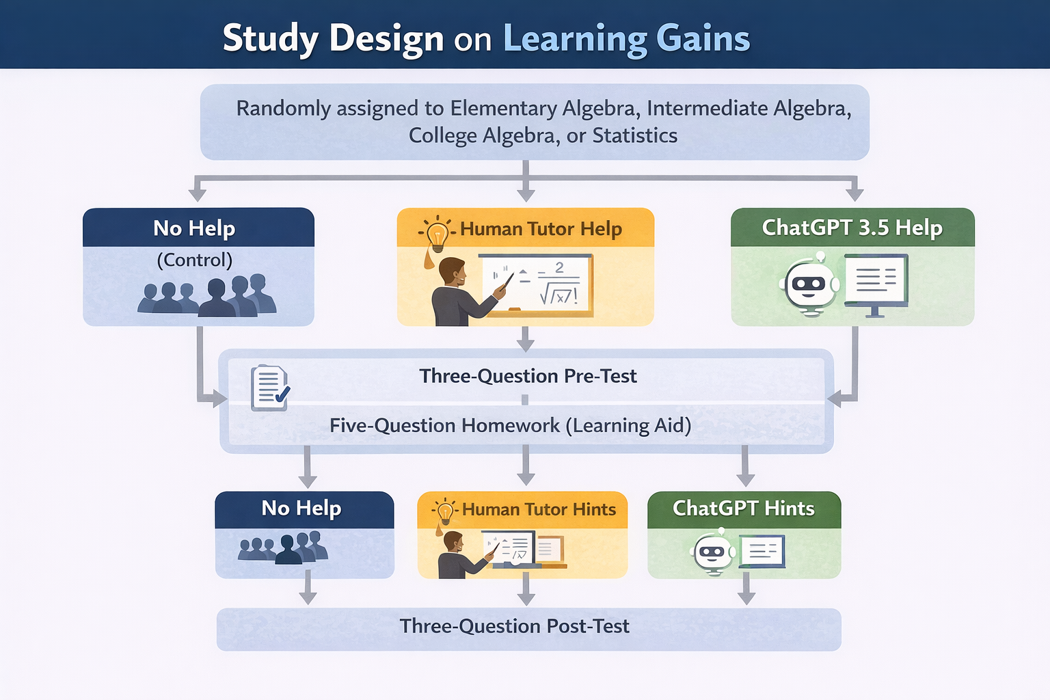
Notes:
Our first study compared improvements in learning when students were given no help (the control group), a human programmed tutor help, or ChatGPT 3.5 tutor help. The subject areas were Elementary Algebra, Intermediate Algebra, College Algebra, and Statistics. Subjects were randomly assigned to a subject and tutor intervention. Individuals were given a three-question pre-test, five question homework to learn the material where the learning aid treatment was applied, and a three-question post-test consisting of the same questions as the pre-test. So, the post-test is right after the intervention.
The human tutor-authored hints were written by UC Berkeley undergraduate students. The student authors developed hints that broke down the task into subtasks or scaffolds. Sort of like “Help Me Solve This” in MyLab. The ChatGPT hints consisted of copying the problem and pasting it as the prompt.

Slide 5
ChatGPT-generated help produces learning gains equivalent to human tutor-authored help on mathematics skills
Research Question: Do ChatGPT hints produce learning gains and how do these gains compare to human tutor-authored help and to no help at all?
Pardos ZA, Bhandari S (2024) ChatGPT-generated help produces learning gains equivalent to human tutor-authored help on mathematics skills. PLoS ONE 19(5): e0304013. https://doi.org/10.1371/journal.pone.0304013
Notes:
The research question was “Do ChatGPT hints produce learning gains and how do these gains compare to human tutor-authored help and to no help at all?”
Let’s look at the results.

Slide 6
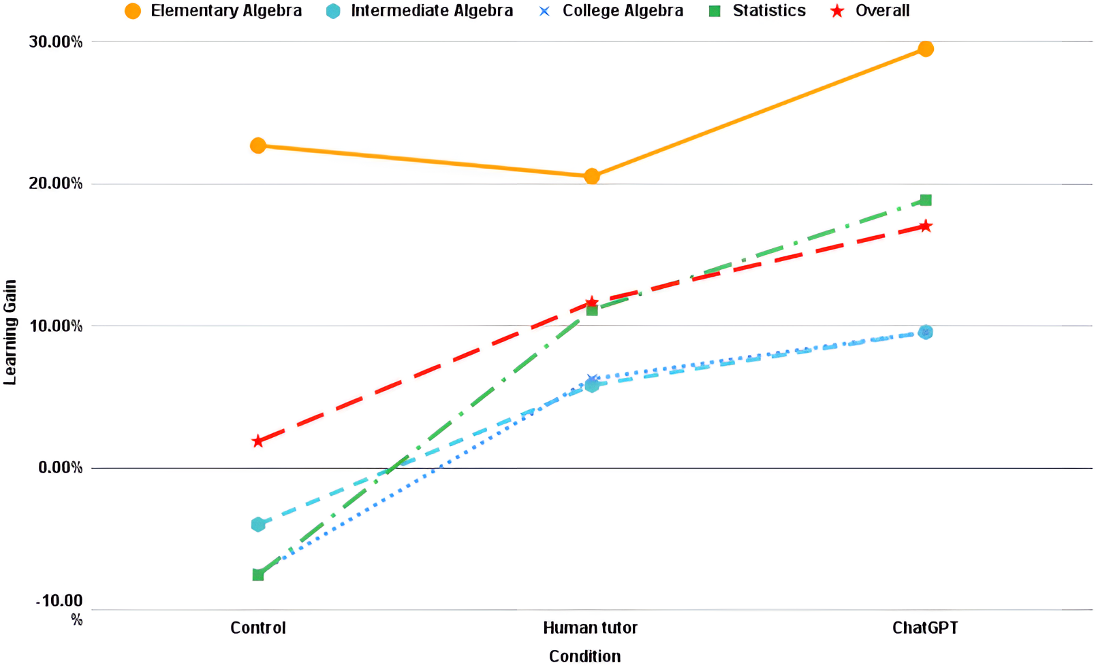
Results
Notes:
Overall, the human tutor and ChatGPT had a statistically significant learning gain. Interestingly, neither intermediate algebra nor college algebra showed a significant learning gain for any of the interventions. In Statistics, only ChatGPT showed a significant learning gain. Also interesting is that there is a negative learning gain in Intermediate Algebra, College Algebra and Statistics for the control (no tutor) group.
Two important items to note. First, the “human tutor” is based on content developed by students at U of C at Berkeley for an open-source program. So, the level of expertise in developing the learning aids may not be at the caliber of other course management systems and certainly not better than a live human tutor. Second, the LLM was ChatGPT 3.5. We are now at ChatGPT 5.2, which is a better trained LLM. Lastly, the prompt used with ChatGPT essentially represented a situation where the answer was simply given to the student. This is not an effective technique to develop learning.

Slide 7
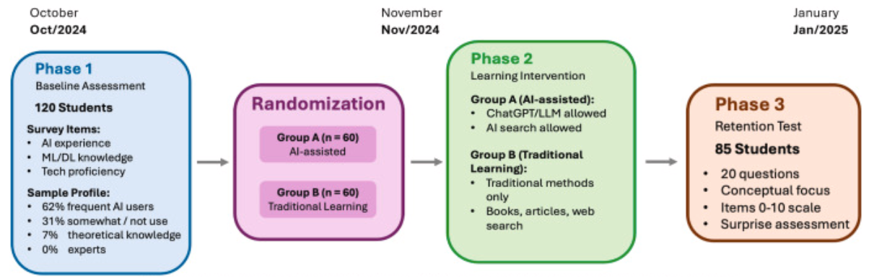
ChatGPT as a cognitive crutch: Evidence from a randomized controlled trial on knowledge retention
Notes:
The previous study suggests that online tutoring systems and ChatGPT produce learning gains. However, a flaw in the study is that the learning may be short-term. After all, the assessment immediately followed the so-called learning. What is the impact of ChatGPT on long-term retention of knowledge? That’s the subject of our next study.
Randomly assigned 120 students who were learning AI and machine learning to use either ChatGPT as a study aid or use traditional, non-AI study methods. Students were then given a surprise assessment after 45 days.

Slide 8
Research Question
Do students who rely on external sources for information storage and processing tend to reduce their own cognitive effort?
If yes, does this negatively impact learning and retention?

Slide 9
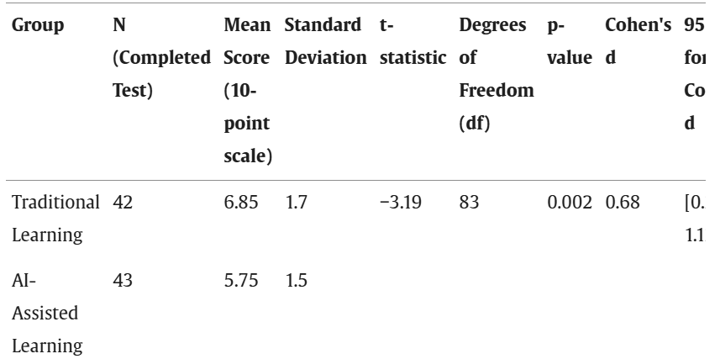
Results
It was also found that students in the AI group had significantly lower times on task (3.2 h vs 5.8 h). So, less time in productive persistence.
Notes:
Scores on a retention exam given 45 days after content was learned. The traditional learning group scored 6.85 while the AI-assisted group scored 5.75. This is a significant difference with a p-value of 0.002. So, students in the AI-assisted group scored significantly worse on the retention exam.
[Click] It was also found that students in the AI group had significantly lower times on task (3.2 h vs 5.8 h). This suggests a lower amount of time in productive persistence. That is, less time in Zone of Proximal Development.

Slide 10
Conclusions
“Grounded in cognitive offloading and desirable difficulties, we ask whether unrestricted access to ChatGPT during self-directed study helps or harms long-term knowledge retention. Cognitive offloading predicts that when external tools shoulder core mental work, learners expend less effort during encoding; desirable difficulties predict that removing productive struggle reduces durable memory.”
“When students use ChatGPT to immediately obtain explanations, examples, or solutions, they bypass the productive struggle that characterizes effective learning.”
https://www.sciencedirect.com/science/article/pii/S2590291125010186#sec9
Notes:
[Click] “Grounded in cognitive offloading and desirable difficulties, we ask whether unrestricted access to ChatGPT during self-directed study helps or harms long-term knowledge retention. Cognitive offloading predicts that when external tools shoulder core mental work, learners expend less effort during encoding; desirable difficulties predict that removing productive struggle reduces durable memory. ”
[Click] “When students use ChatGPT to immediately obtain explanations, examples, or solutions, they bypass the productive struggle that characterizes effective learning.”

Slide 11
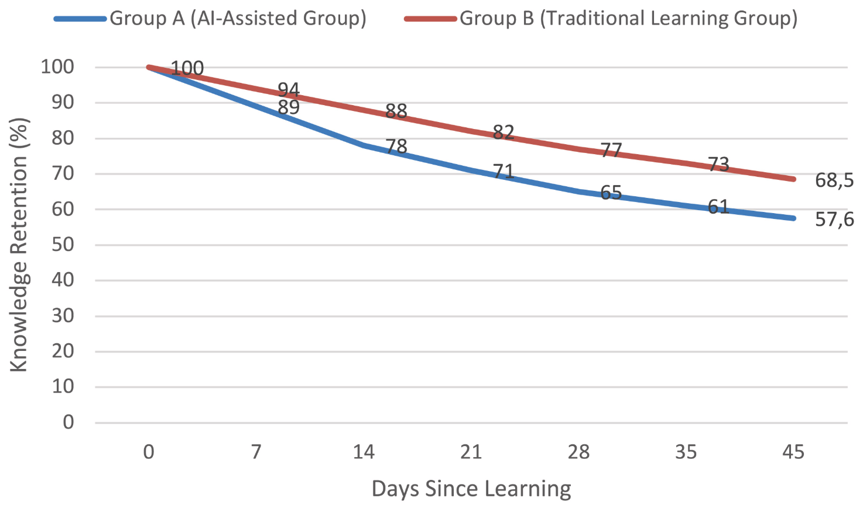
The “Forgetting Curve”
Notes:
In other words, this leads to a situation where students do not retain the knowledge over time. Here is the “forgetting curve” over the 45 days. The two curves are interpolated based on the day 0 and day 45 measurements.
The Forgetting Curve is an exponential decay model where the independent variable is days since learning. The dependent variable is knowledge retention.

Slide 12
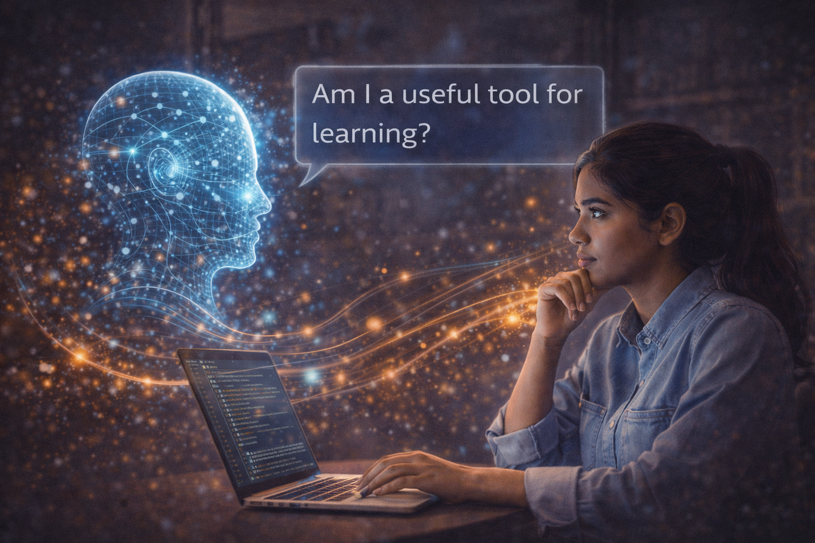
Notes:
Can generative AI be used as an effective tool for learning?

Slide 13
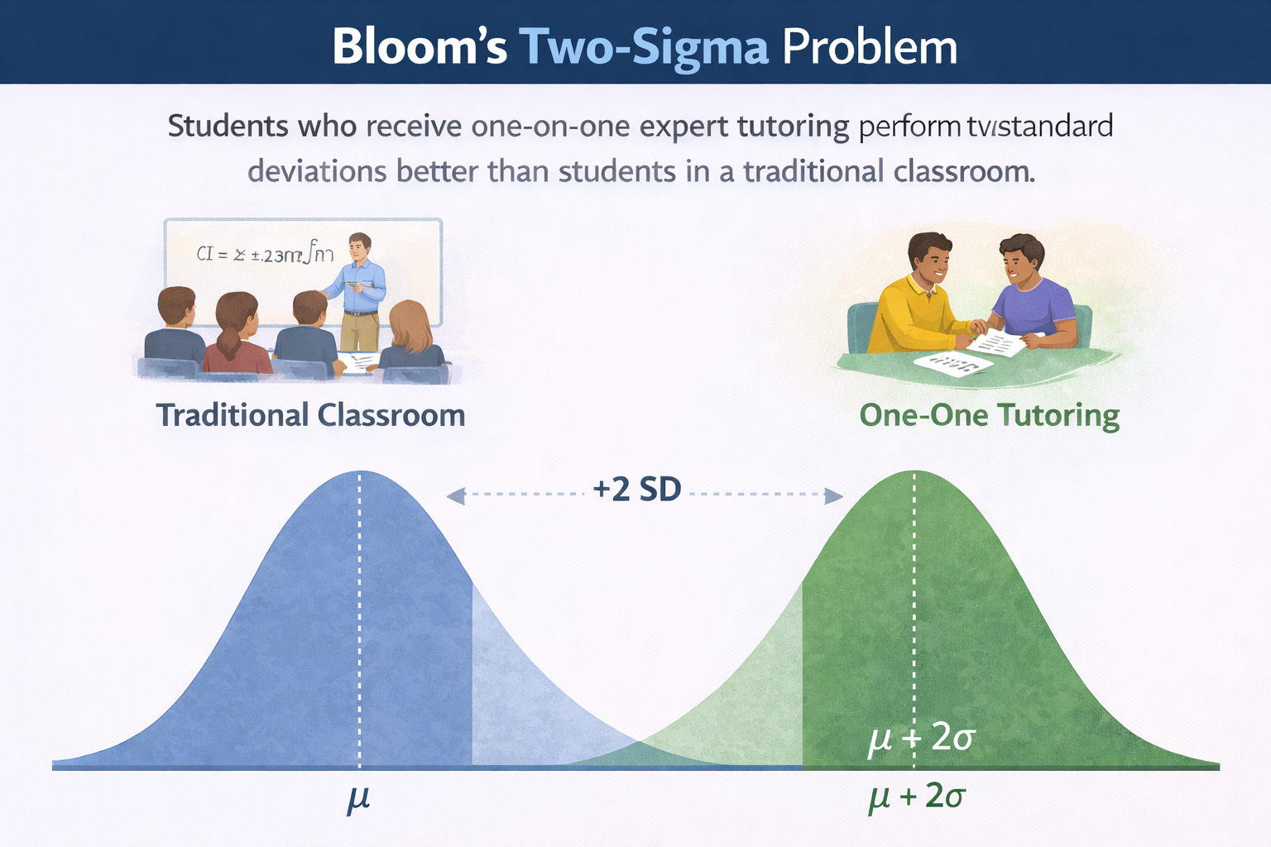
Bloom, B. S. The 2 sigma problem: The search for methods of group instruction as effective as one-to-one tutoring. Educ. Res.13(6), 4–16 (1984).
Notes:
Bloom's Two-Sigma Problem is the observation that students who receive one-on-one expert tutoring perform two standard deviations better than students in a traditional classroom. The problem is that one-on-one tutoring is not scalable. Some of you may recall that a solution to this problem was the emporium model. This model allowed students to work in a lab setting at their own pace where the instructor served as the guide on the side. Students could self-accelerate through the program. It was adopted primarily to address the problem that students were coming to college without the necessary math skills to enroll in a college level math course.
Can AI mimic the learning experience one would get from an expert human tutor? Researchers at Harvard University attempted to answer this question in a randomized controlled experiment.

Slide 14

AI tutoring outperforms in-class active learning: an RCT introducing a novel research-based design in an authentic educational setting
https://pmc.ncbi.nlm.nih.gov/articles/PMC12179260/
Notes:
This study was conducted as a randomized controlled experiment of an undergraduate physics course. During week 1 of classes, 194 students were randomly assigned to either an AI-supported lesson at home or an active learning lesson in class. The treatments were reversed in week 2. To establish baseline knowledge, students from both groups completed a pre-test prior to each lesson. Following each lesson, students completed a post-test. Learning gains were measured from baseline knowledge. Note: Harvard is home to Eric Mazur who championed the importance of active learning. He also developed Learning Catalytics, which is an online personal response system available through Pearson’s MyLab.

Slide 15
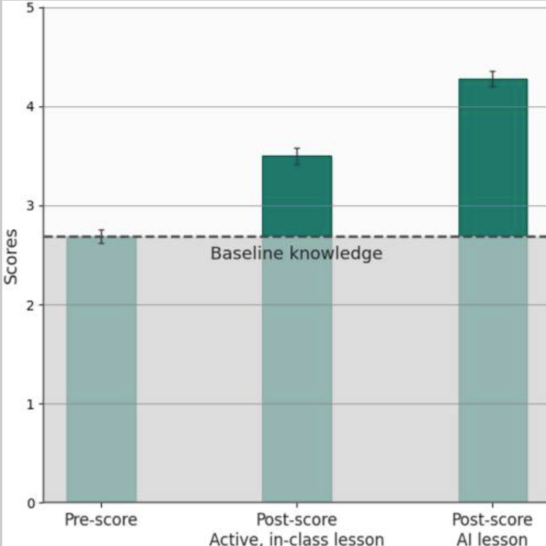
M = 4.5
M = 3.5
M = 2.75
Notes:
Learning gains were measured by comparing the post-test scores of the AI group and the in-class active learning group to the pre-test scores of the two groups combined. Students in the AI group exhibited a higher median (M) post-score (M = 4.5, N = 142) compared to those in the in-class active learning group (M = 3.5, N = 174). The median learning gains for students, relative to the pre-test baseline (M = 2.75, N = 316), in the AI-tutored group were over double those for students in the in-class active learning group. A two-sample rank-sum (Mann–Whitney) test was used to compare the distribution of post-scores of the two groups. The analysis revealed a statistically significant difference (z = -5.6, p < 10^{–8}). The figure shows aggregate results (weeks 1 and 2 combined)⁶ of the learning gains for the group taught with in-class active learning compared to the group taught with the AI tutor.
Comparison of learning gains: A comparison of mean post-test performance between students taught with the in-class active learning and students taught with the AI tutor. Dotted line represents students’ mean baseline knowledge before the lesson (i.e., the pre-test scores of both groups). Error bars show one standard error of the mean.

Slide 16
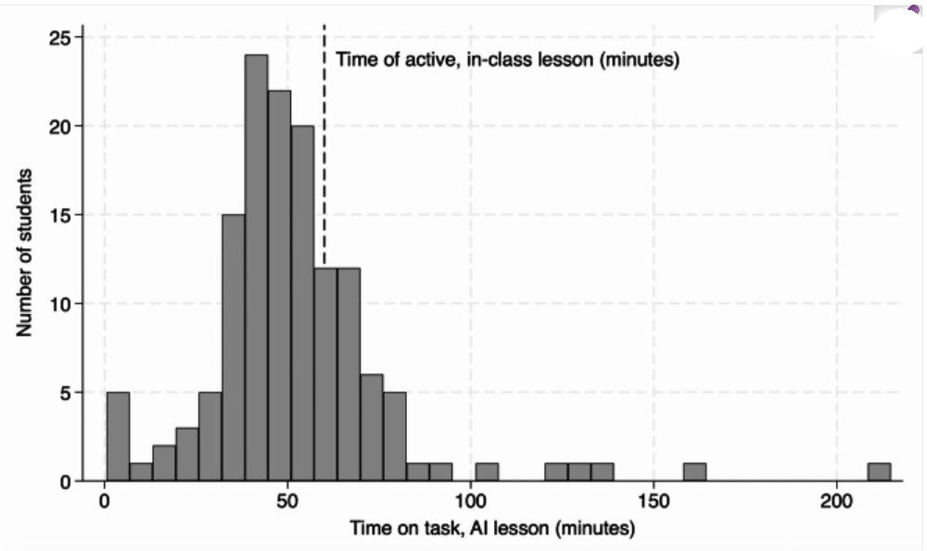
Time on Task
60 minutes
Notes:
During a 75-minute period, the in-class students spent 15 minutes taking the pre- and post-tests; which left 60 minutes spent on learning. For students in the AI group, their use of the AI tutor platform was tracked to measure how long they spent on the material. See the distribution. Notice that 70% of students in the AI group spent less than 60 minutes on task, while 30% spent more than 60 minutes on task. The median time on task for students in the AI group was 49 minutes. In the AI group students spent the time needed to learn the material and then moved on. This flexibility is not available in the active learning environment.

Slide 17
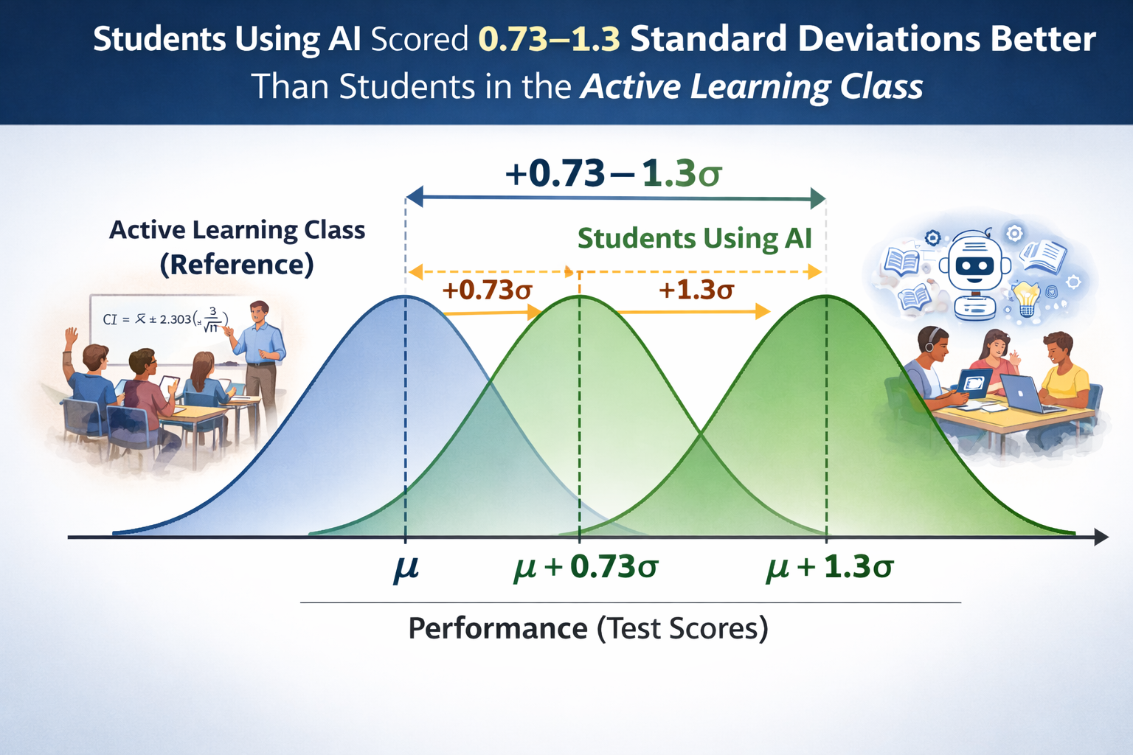
Results
Notes:
Using advanced methods that controlled for variables such as incoming course knowledge, experience with ChatGPT, and class topic covered in week 1 vs. week 2, it was found students using AI scored between 0.73 and 1.3 standard deviations better than students in the active learning classroom. So, not quite the 2 standard deviation gain of one-on-one tutoring, but better than an active classroom setting (and certainly better than a passive classroom lecture setting).

Slide 18
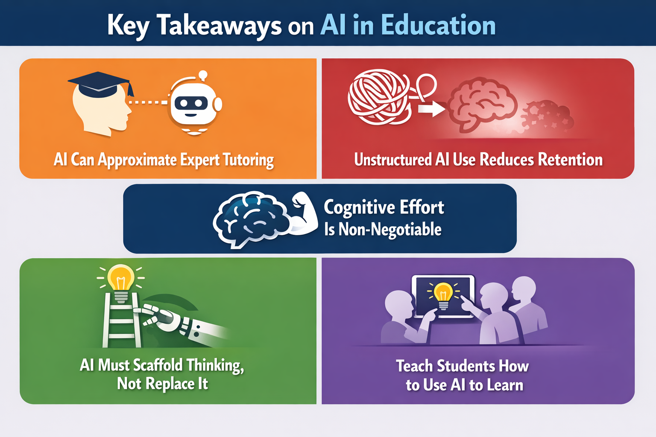
Notes:
Let’s recap where we are. Study #1 suggested AI can be used to assist in learning, but the ”learning” was short-term. Study #2 suggested that AI-assisted learning has a greater rate of decay than traditional learning. Study #3 suggested an AI-tutor can outperform an active classroom. However, the ”learning” in Study #3 was also short-term. So, can we teach students how to prompt their favorite LLM to avoid cognitive offloading while harnessing the role AI could play in acting as an expert tutor?
I am in the camp that says LLMs can be used in the early stages of learning while behaving as a tutor. LLMs should be used as a Socratic tutor to assist in learning, not as a mechanism for providing answers. Ultimately, this tool must be put away to make sure students operate in the Zone of Proximal Development. This is non-negotiable.
I recall when I was in school, I would use resources such as solution manuals to help me learn the material. However, I would always go back and redo my homework a second and third time without this aid to prove I knew the content. This is what our students need to be encouraged to do as well. At the end of the day, LLMs are not a panacea. Students must put in the hard work. Just as you cannot watch someone play the piano and expect to be an expert pianist, you cannot use LLMs (or any other resource) to complete homework and expect to do well on an exam.

Slide 19
AI Doesn’t Have to Rot Your Mind
If you use your chatbot as a coach, not a crutch, it can help you hone your own memory and reasoning skills.
By Nelson Dellis
March 27, 2026
Wall Street Journal
https://www.wsj.com/opinion/ai-doesnt-have-to-rot-your-mind-4516add0?st=NYryrY&reflink=article_gmail_share
Notes:
Article by Nelson Dellis regarding how AI should be used tool for learning by using AI as a Socratic tutor.

Slide 20
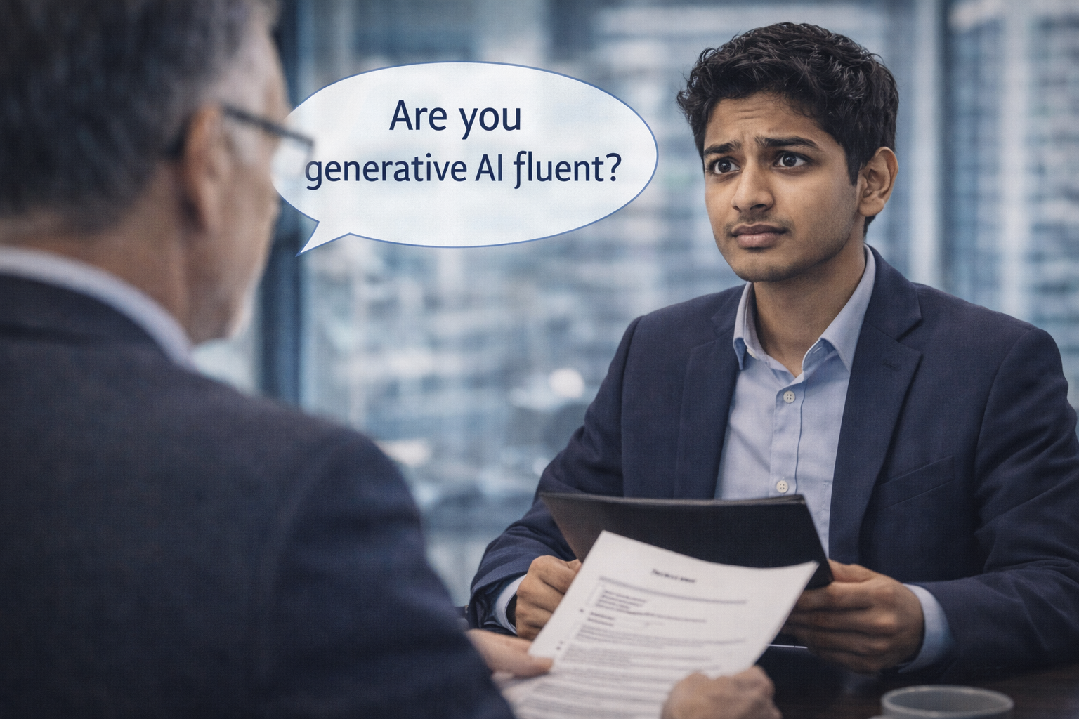
“AI Is Going to Change Literally Every Job” Wall Street Journal 9/25/25
“How I Killed—and Revived—Teamwork With AI” Wall Street Journal 2/25/26
Notes:
If you are on the fence regarding the use of AI in your classrooms, I ask you to consider one other factor. When our students leave our universities, they are going to submit themselves to the workforce. What skills do current employers expect recent grads to have? Here are some quotes from current CEOs:

Slide 21
Accenture CEO Julie Sweet
The firm is “exiting” employees who can’t be retrained for the AI age. Meanwhile, it will continue to hire people who are generative AI-fluent and retrain existing workers to serve clients in consulting and other divisions.

Slide 22
Omri Yoffe, CEO of Vi, an AI Healthcare Company
Employees need to think of the current moment in almost Darwinian terms. Those who fail to evolve, learn new skills and create higher-value roles for themselves might be left behind.

Slide 23

Can This Be Done with Generic LLMs?
Act as a Socratic tutor
Good prompting
Scaffolding
Ultimately put away the LLM
Notes:
Now, let’s see how an LLM may be used as a tutor.

Slide 24
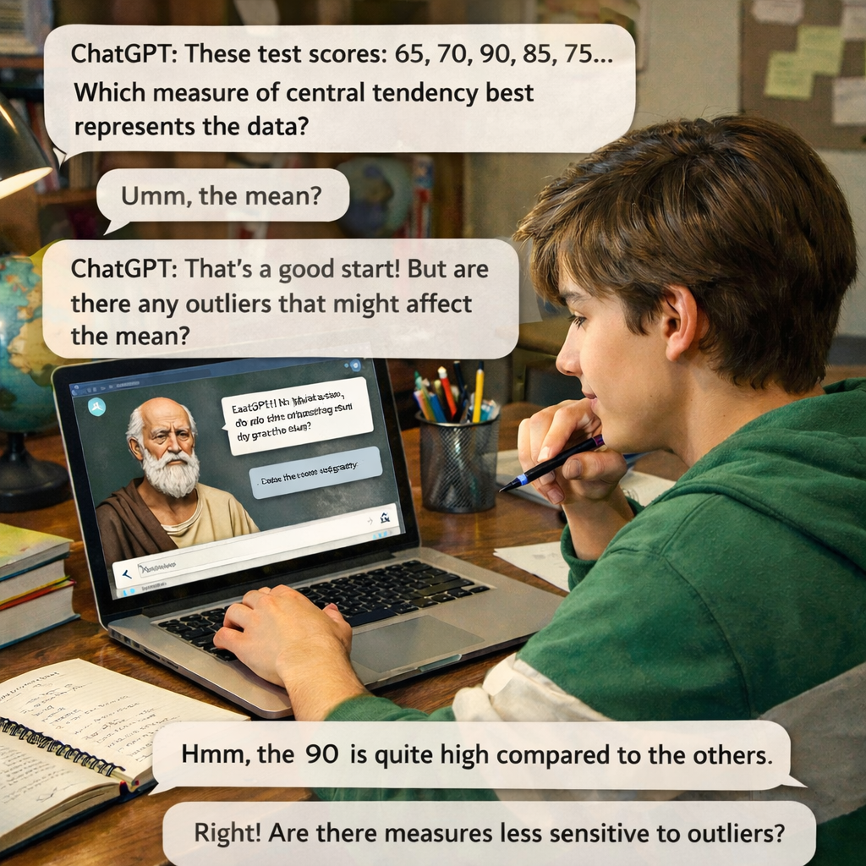
Using LLMs as a Socratic Tutor
In ChatGPT, switch to “Study Mode”. How.?
Click + then More then “Study and learn”.
In Google Gemini, select “Guided Learning”.
Or, ask any LLM to behave as a Socratic tutor. Don’t give the answer, but help me to learn how to solve the problem.
Notes:
Go to ChatGPT. Click + next to “Ask anything”. Click More. Choose “Study and Learn”
Metacognition (Flavell). Commonly referred to as “thinking about thinking”. Plan > Monitor > Assess…
How AI can help with Metacognition…Use AI as a Thinking Partner
Ask reflective questions instead of providing solutions
Offering feedback that promotes self-explanation
Personalizing practice while encouraging strategic thinking
Modeling growth mindset language
Google Gemini has “Guided Learning” under Agents.

Slide 25
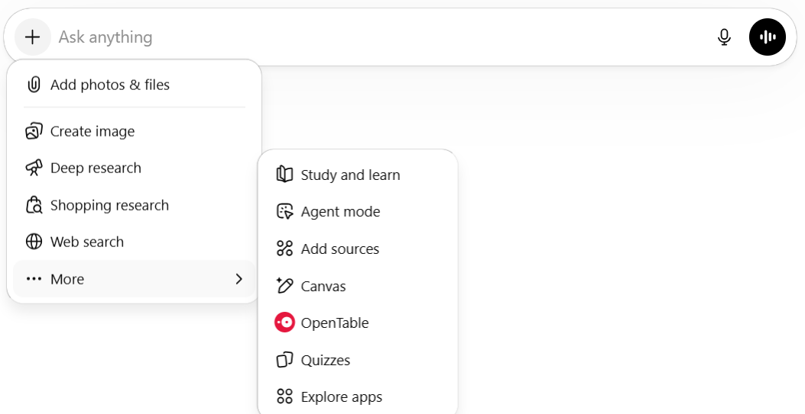
ChatGPT 5.4 Thinking
Notes:
Let’s try using ChatGPT as a tutor.

Slide 26
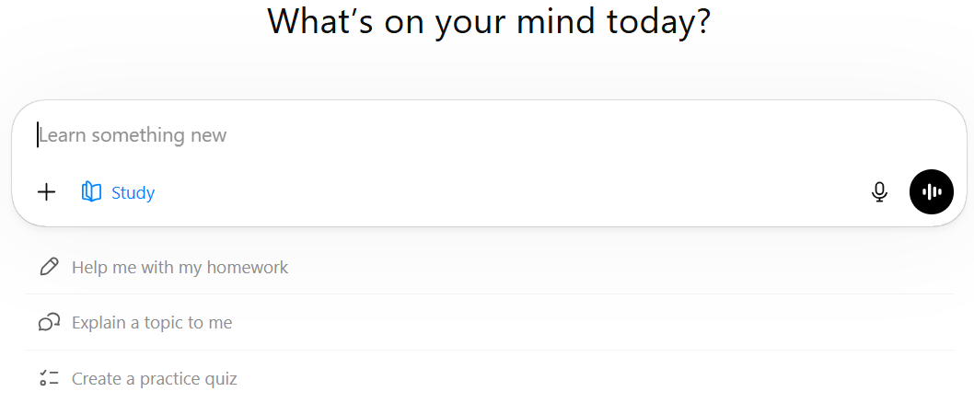
ChatGPT 5.4 Thinking

Slide 27
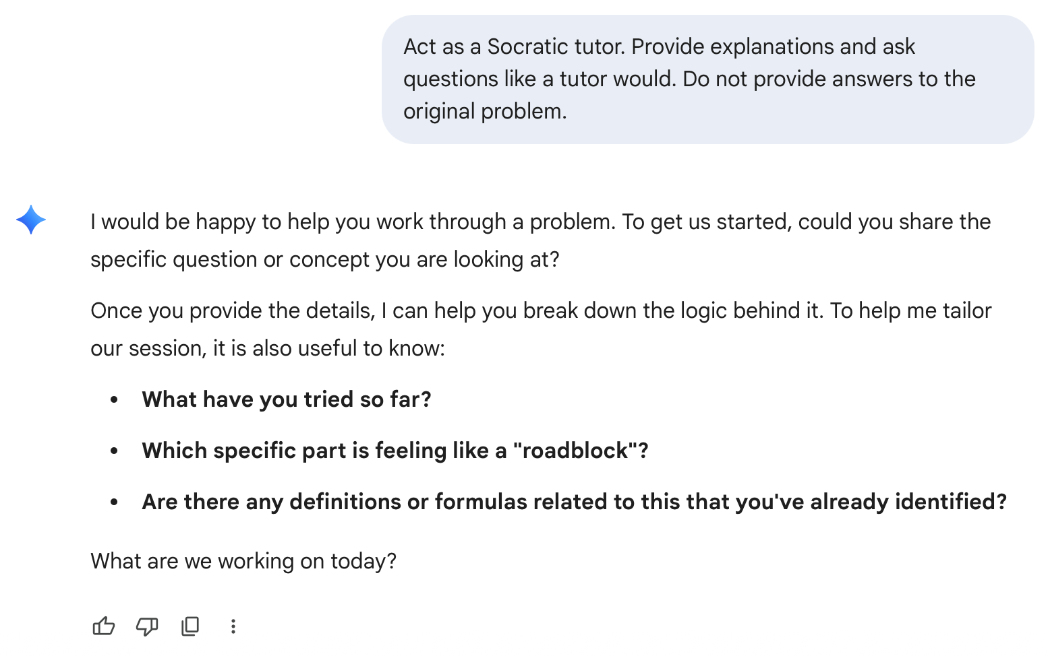
Google Gemini

Slide 28
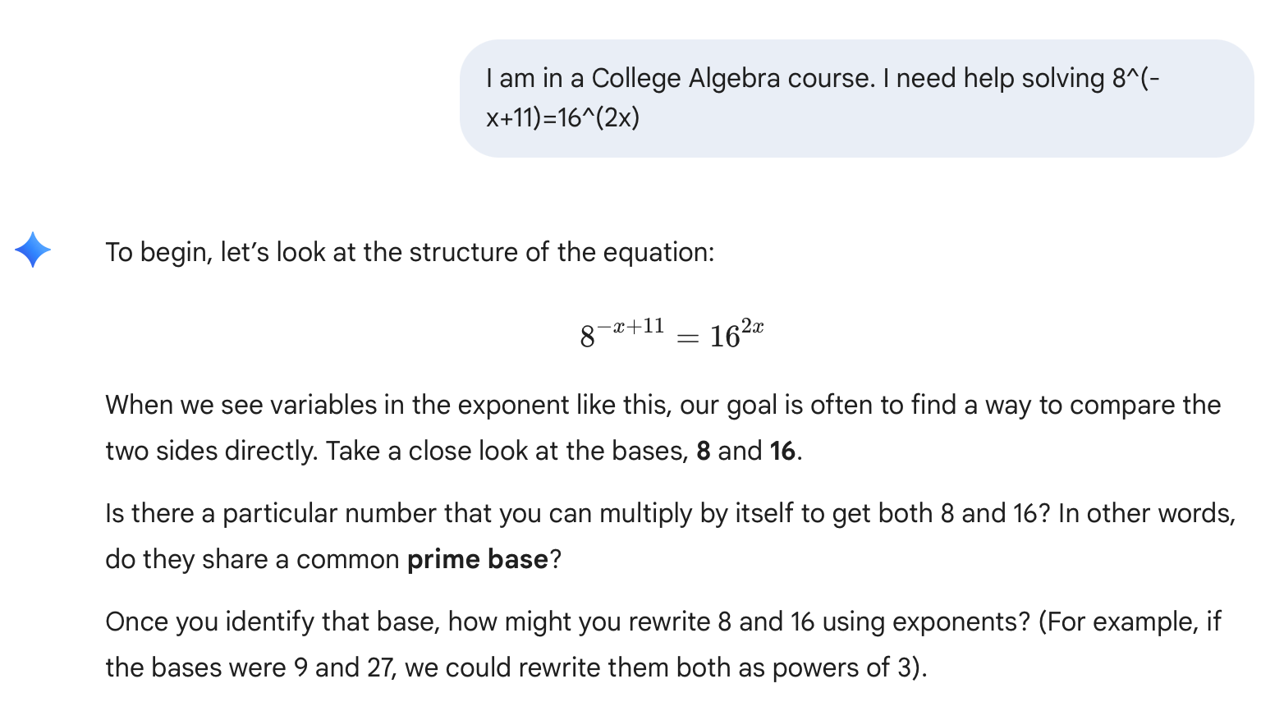
Google Gemini

Slide 29
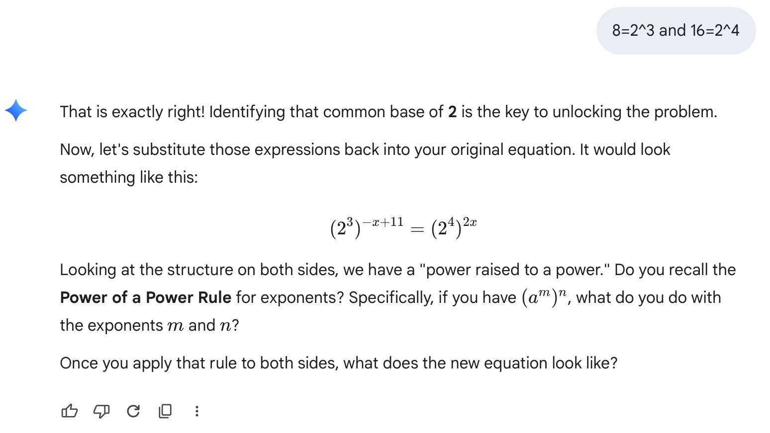
Google Gemini

Slide 30
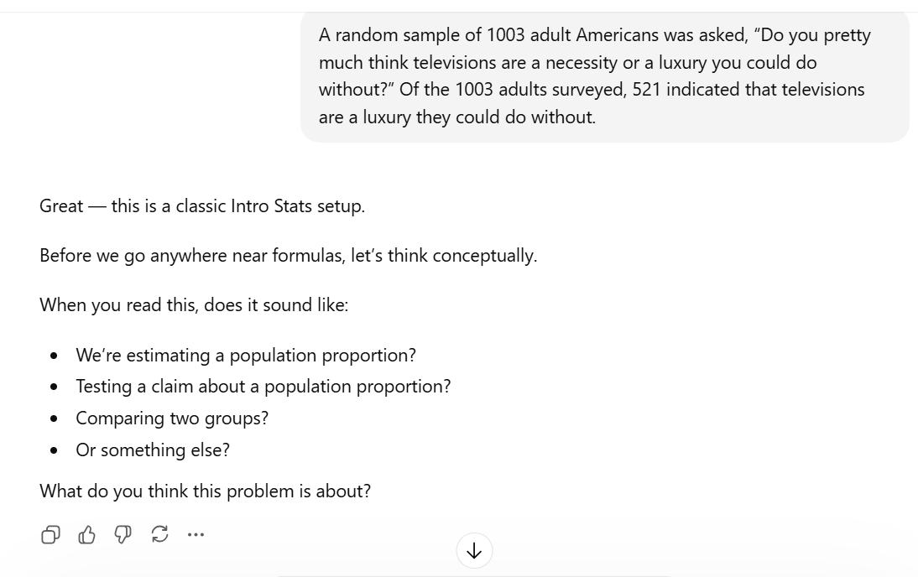
ChatGPT 5.4 Thinking

Slide 31
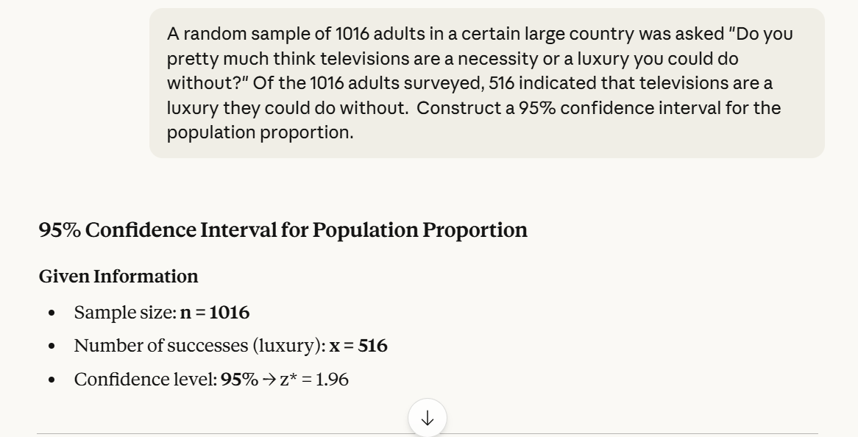
Poor Prompting
Notes:
Click on the image.

Slide 32
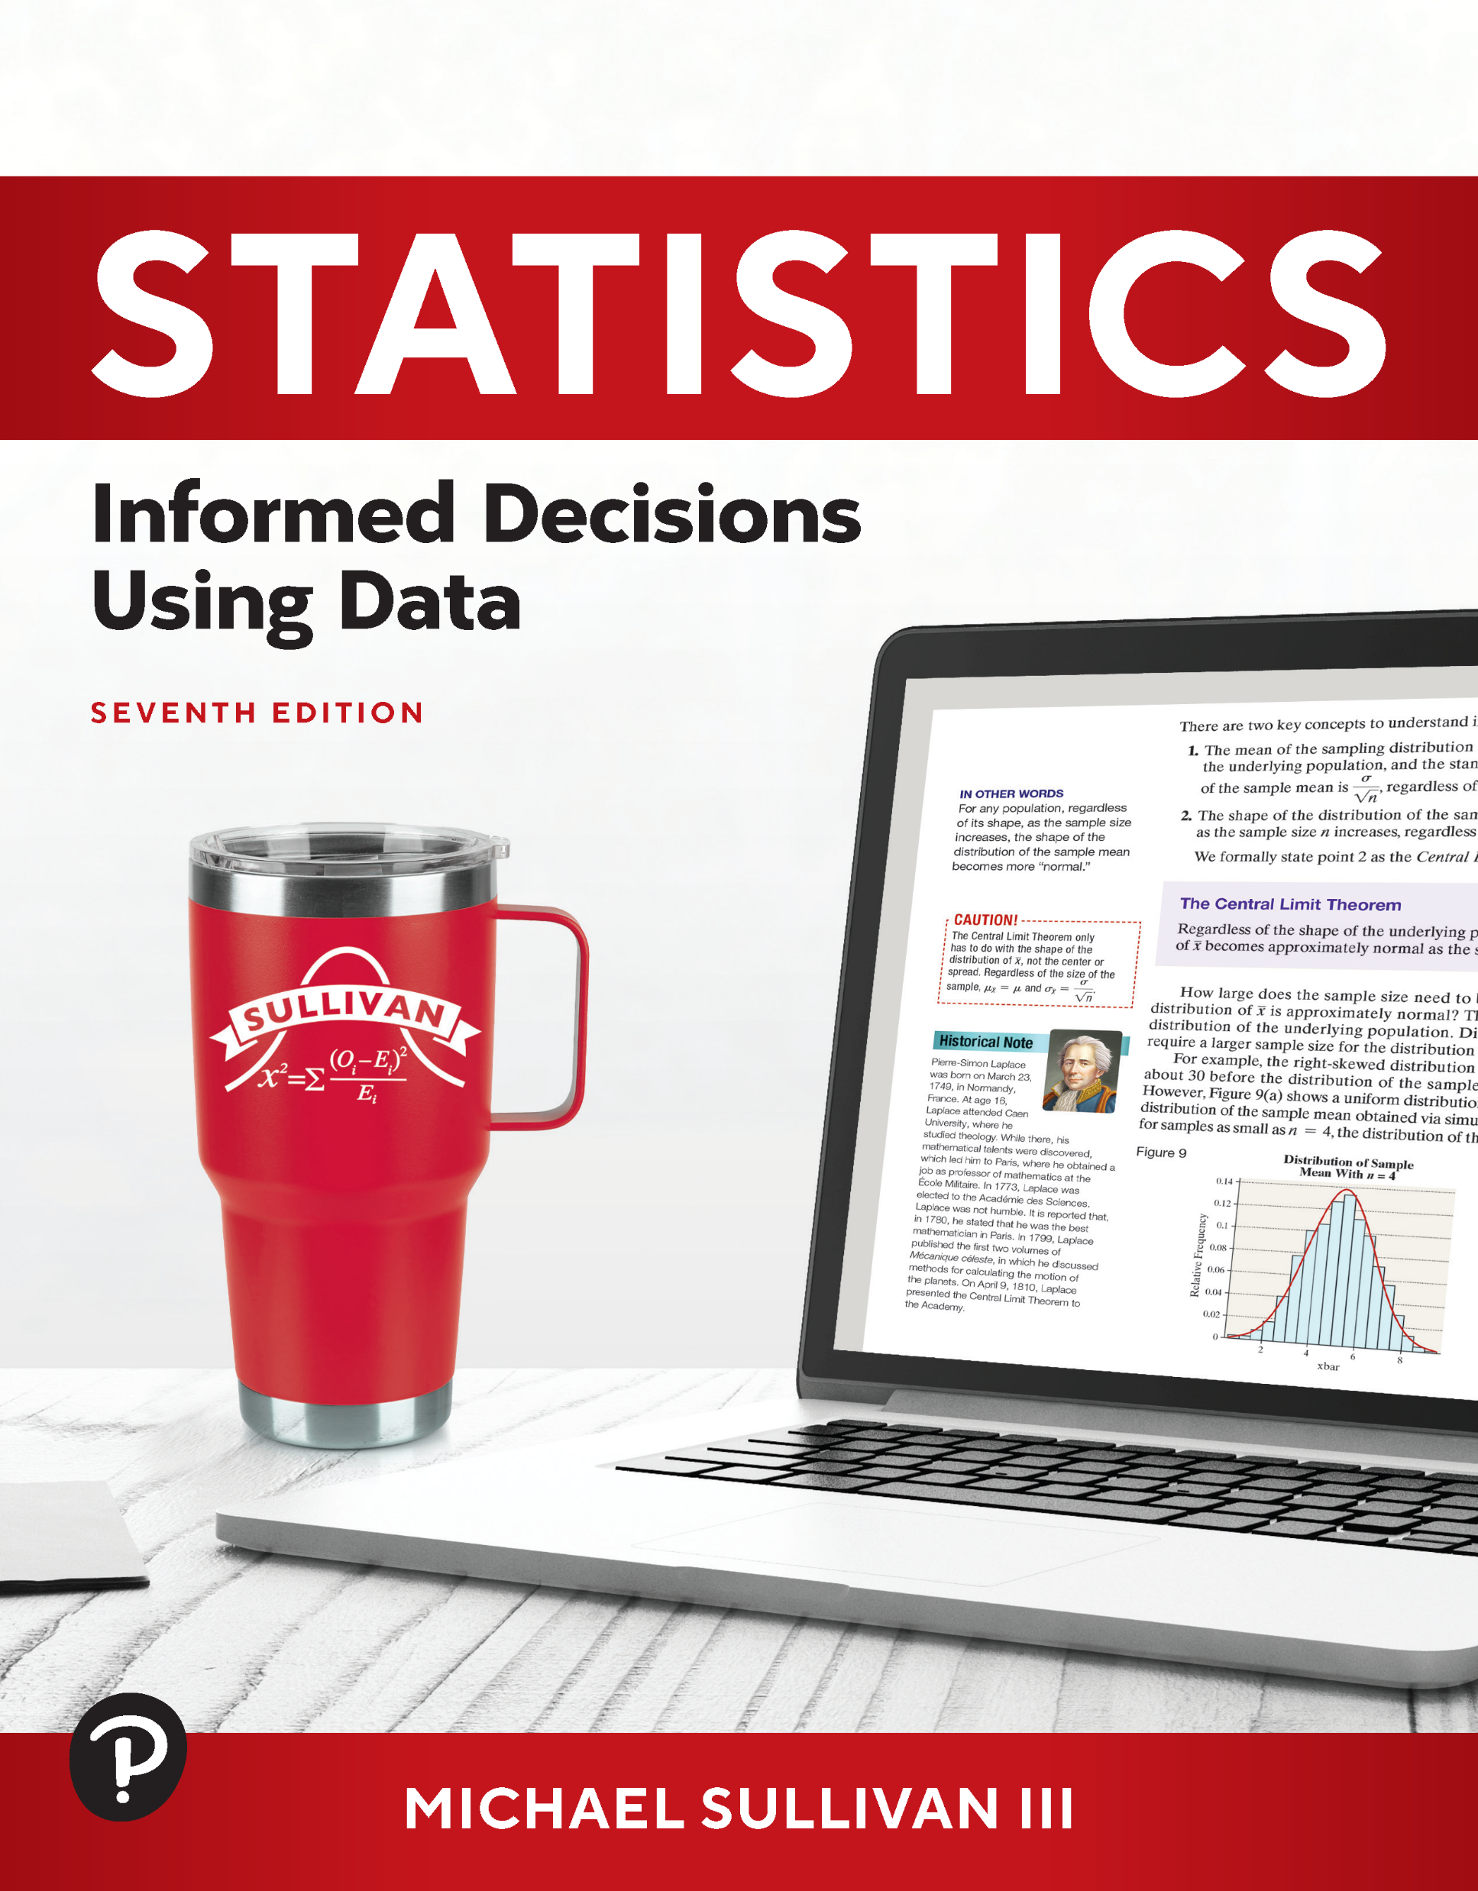
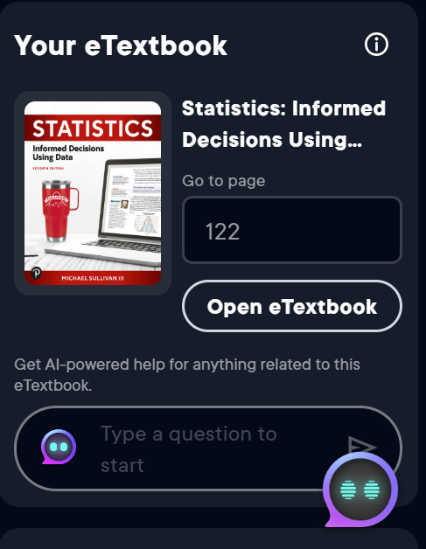
Using AI with Your Pearson Textbook
Notes:
I now want to transition to some AI tools available in your MyLab course.
Log into your Pearson MyLab and access a course. Click eTextbook Contents and select “Open my eTextbook”. You will be taken to the Pearson+ page. The eTextbook appears on the right side of the page. Click “Open eTextbook”

Slide 33

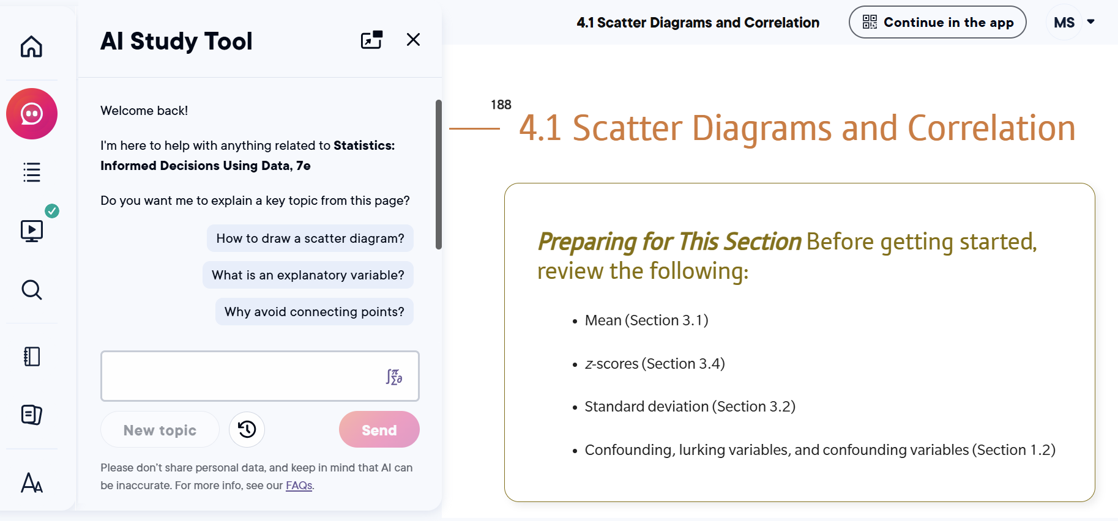
Notes:
Click the AI Study Tool icon in the upper left corner. Once the student clicks the icon, the AI Study Tool asks if they would like an explanation of a key topic from the chapter or section the student is working on. For example, if the student is working on Section 4.1 Scatter Diagrams and Correlation, the AI Study Tool asks if the student would like to know How to draw a scatter diagram; What is an explanatory variable; or Why avoid connecting the dots. At the bottom of the tool, the student can ask AI to summarize, practice, or explain any topic.

Slide 34
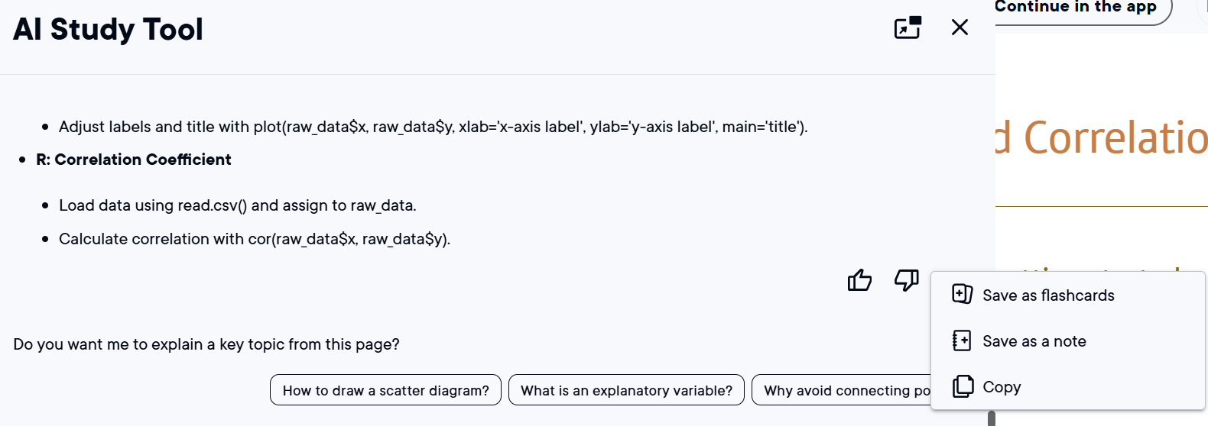
Notes:
Open Section 4.1. Scroll down and click “Summarize”. Choose current section. AI provides a thorough summary of the material in the section. At the end of the summary, there are three dots. Click on the three dots. The student can 1. Save as flashcards 2. Save as a note 3. Copy. If the student copies the material, it may be pasted into a Word Processing program like Word for later use. If the student clicks “Save as flashcards”, then flashcards are created from the content in the summary.

Slide 35
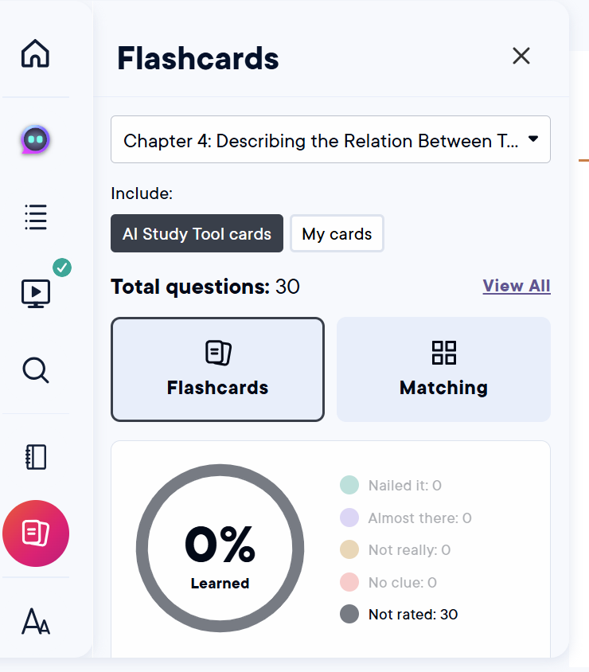
Notes:
Click the Flashcard icon. From the drop-down menu, select Chapter 4. Highlight “AI Study Tool cards”. Scroll down and select Practice. The flashcards are presented and the student may reveal the answer and then self-assess their level of confidence in knowing the material. It also creates a matching exercise for vocabulary.

Slide 36
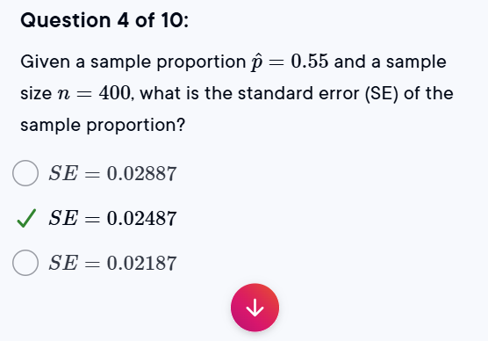
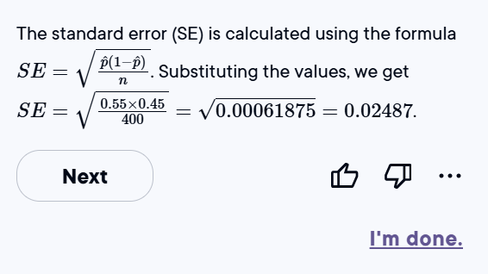
Notes:
Click the AI icon. Click “New topic”. Move to Section 9.1 Estimating a Population Proportion. Select Practice. AI generates a set of 10 questions to work on in the AI Study Tool. It provides solutions after the student selects “Submit”. The student can save any question as a flashcard or copy it to the clipboard and paste into a Word Processor.

Slide 37
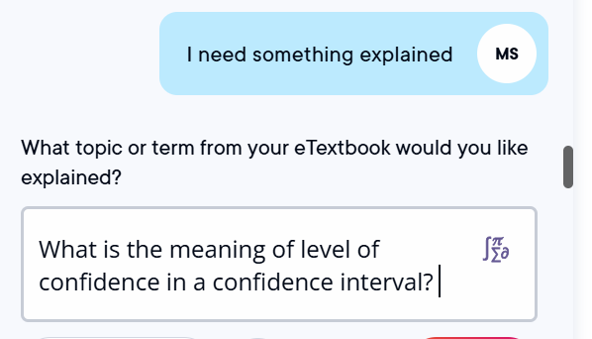
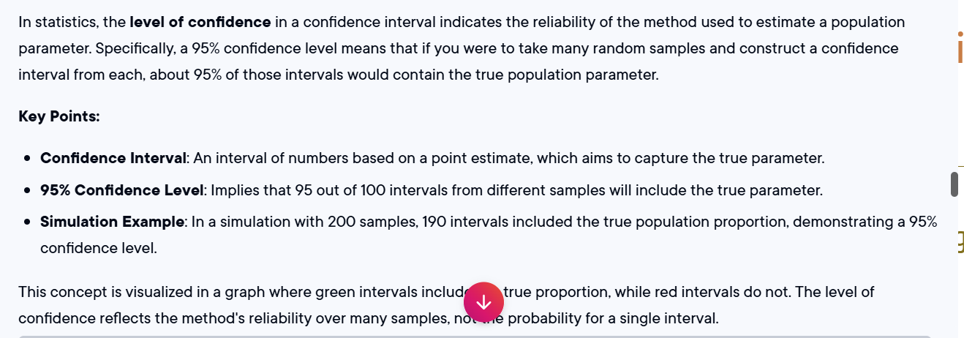
Notes:
Click “I’m Done”. The student can select “Explain” and type any question desired to get a complete answer (again, in the language found in the eTextbook). Click “Explain”. Type in your question and click Submit. AI provides an answer using the exact language found in the text.

Slide 38
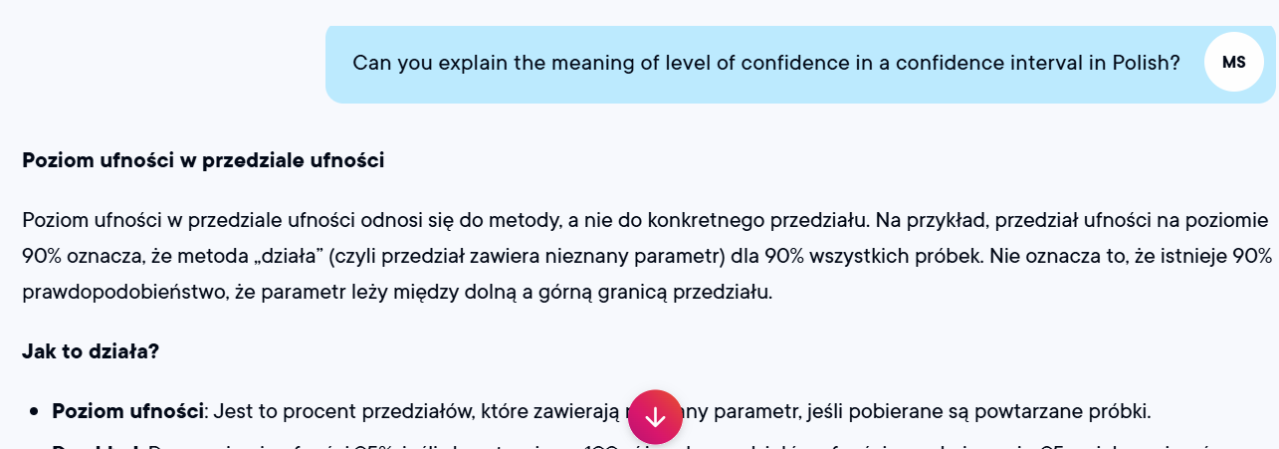

Slide 39
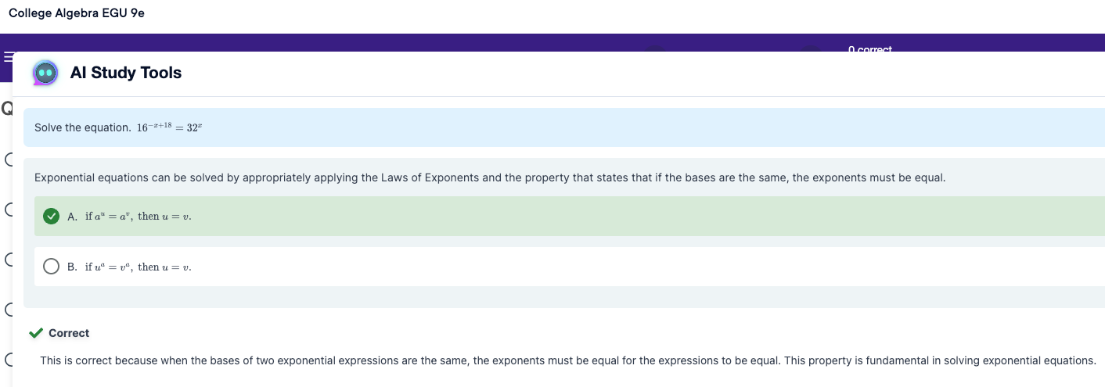
Pearson’s AI Study Tool
Notes:
Show 4.1.25 from Stats 7e. Be sure to show how to enable the AI Study Tool in MML Settings.

Slide 40
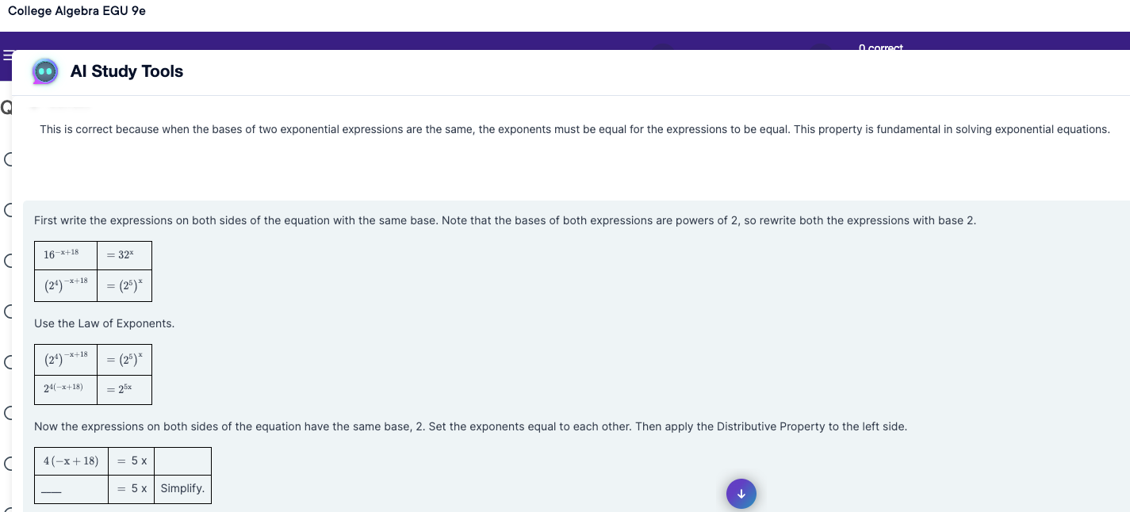
Pearson’s AI Study Tool

Slide 41
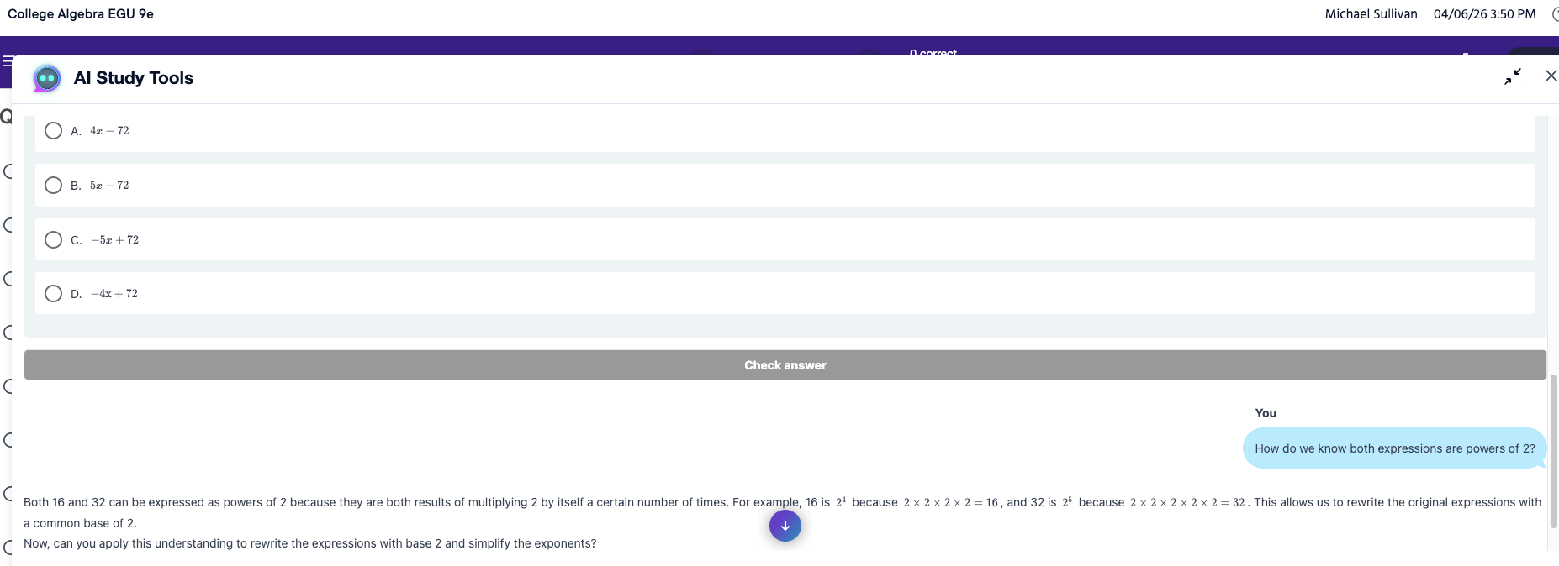
Pearson’s AI Study Tool

Slide 42
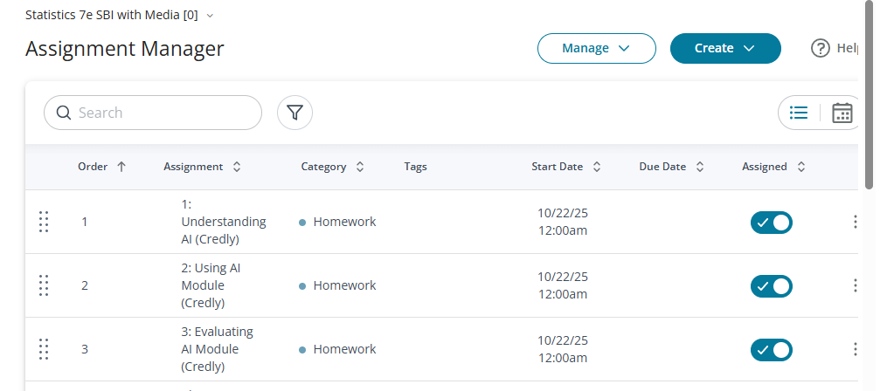
Pearson’s AI Literacy Modules
Notes:
Pre-built assignments in MyLab and they're meant to help students navigate the what/why/how of using AI ethically in learning. These are pre-built assignments that can be copied into your course using the Assignment Manager.
Assignment Manager > Create > Import from Another Course. Choose AI from the drop-down menu. Add to your course.

Slide 43
Instructor Use of LLMs
Open an LLM (Google Gemini, ChatGPT, Grok, Claude)
Prompt: I am teaching an introductory statistics course to my community college students. I have taught scatter diagrams and correlation. Now, I need to teach least-squares regression with a single explanatory variable. Help me develop an activity that introduces least-squares regression. The activity should include a conceptual understanding of minimizing the sum of squared residuals.

Slide 44
Chicago Salary Data (Gemini)
https://sullystats.github.io/Data/ChicagoSalaries.csv
Load this data to an LLM.
Prompt 1: Write an activity that students can perform in small groups that teaches confidence intervals for a mean using this data. Include the idea of meaning of level of confidence.
Prompt 2: Okay. How would things change if we did not know the population standard deviation?
Notes:
Ask instructors to do this with us. What results do they get?

Slide 45
ChatGPT
Prompt: Write a ten-question quiz that covers topics related to the binomial probability distribution.

Slide 46
Fun Stuff
https://chatgpt.com/share/68f7e424-b718-800b-bb4c-77ad8bbe2707

Slide 47
Other Ideas
Upload an existing assignment and ask AI to improve it (or incorporate AI into it)
Ask AI to improve/create a grading rubric for existing assignments
Ask AI to suggest ways you could improve your teaching a certain topic
Ask AI to find examples that illustrate a concept (such as Simpson’s Paradox or influential observations)

Slide 48


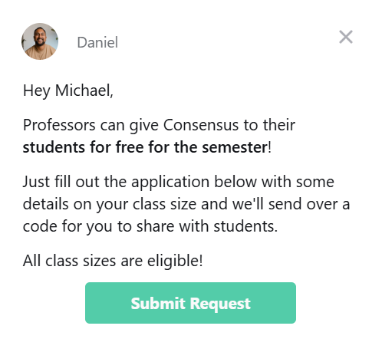
Notes:
Consensus is similar to ChatGPT, but it is based on peer-reviewed studies. Perpexlity uses social media resources to inform its output.

Slide 49
Consensus
Prompt: I need an example with real data that illustrates the concept of Simpson's Paradox from introductory statistics.

Slide 50
Perplexity
Prompt: Create a data set with about 30 observations and a variety of variables based on Spotify downloads.

